Slide 1
Lecture 2: Linear Regression

Slide 2
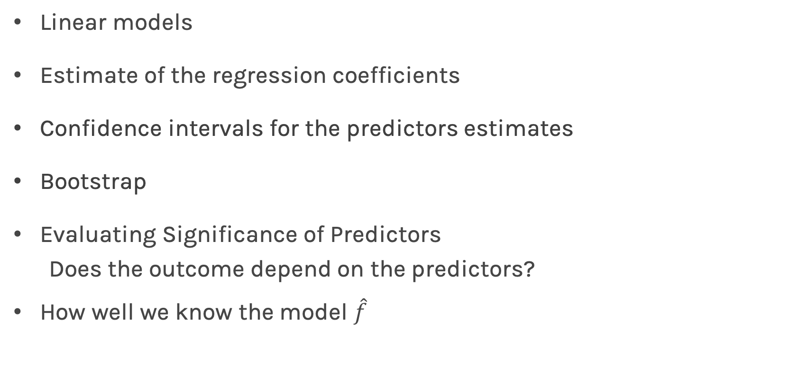
Lecture Outline
Linear models
Estimate of the regression coefficients
Confidence intervals for the predictors estimates
Bootstrap
Evaluating Significance of Predictors
Does the outcome depend on the predictors?
How well we know the model $\hat{f}$

Slide 3
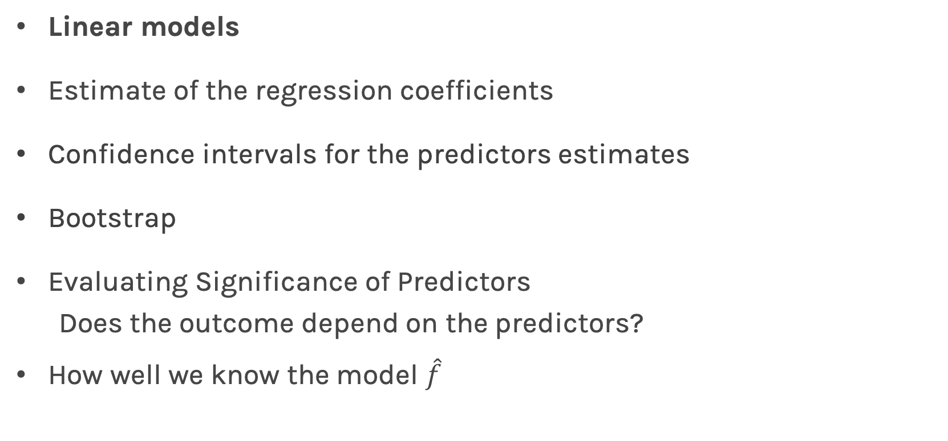
Lecture Outline
Linear models
Estimate of the regression coefficients
Confidence intervals for the predictors estimates
Bootstrap
Evaluating Significance of Predictors
Does the outcome depend on the predictors?
How well we know the model $\hat{f}$

Slide 4
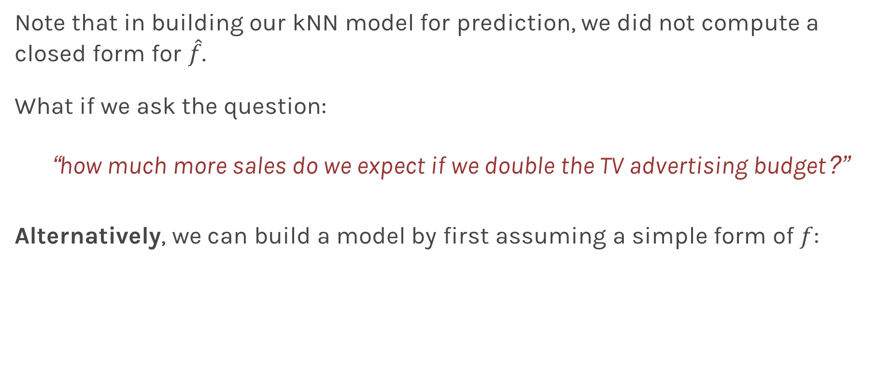
Linear Models
Note that in building our kNN model for prediction, we did not compute a closed form for $\hat{f}$.
What if we ask the question:
“how much more sales do we expect if we double the TV advertising budget?”
Alternatively, we can build a model by first assuming a simple form of $f$:

Slide 5
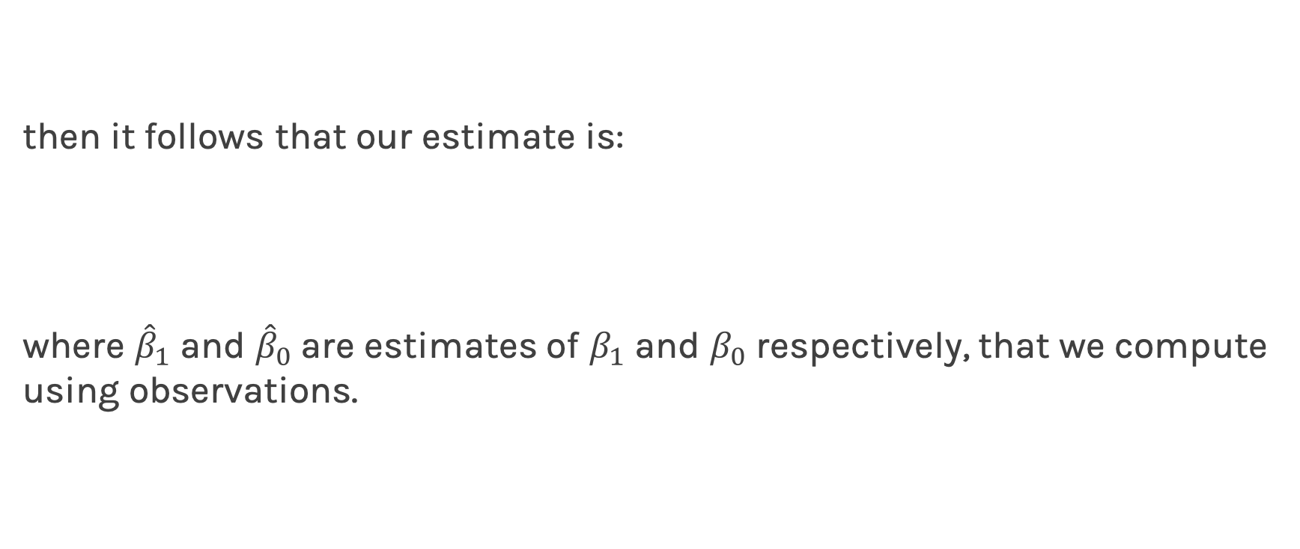
Linear Regression
then it follows that our estimate is:
where ${\hat{β}}_{1}$ and ${\hat{β}}_{0}$are estimates of $β_{1}$ and $β_{0}$ respectively, that we compute using observations.

Slide 6
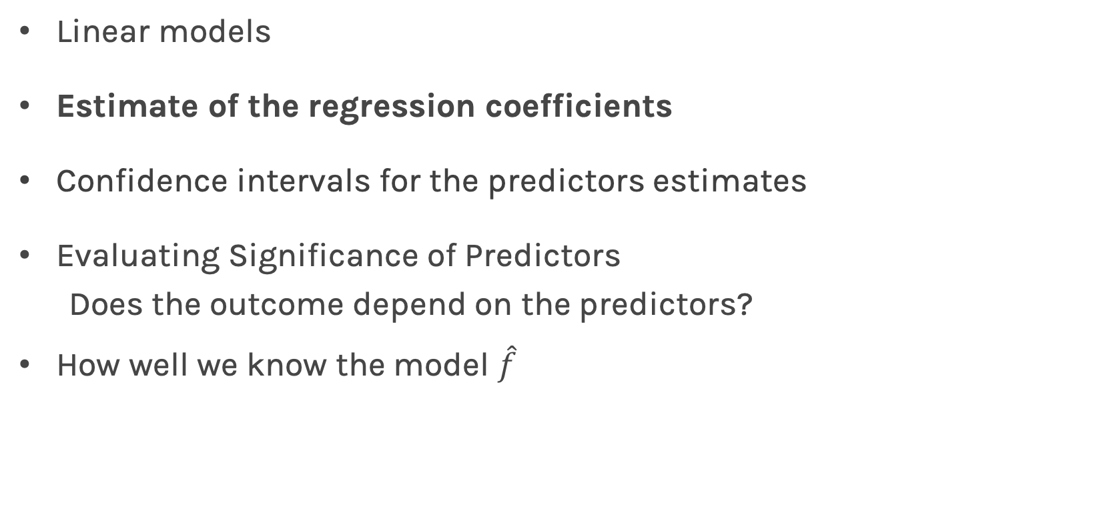
Lecture Outline
Linear models
Estimate of the regression coefficients
Confidence intervals for the predictors estimates
Evaluating Significance of Predictors
Does the outcome depend on the predictors?
How well we know the model $\hat{f}$

Slide 7
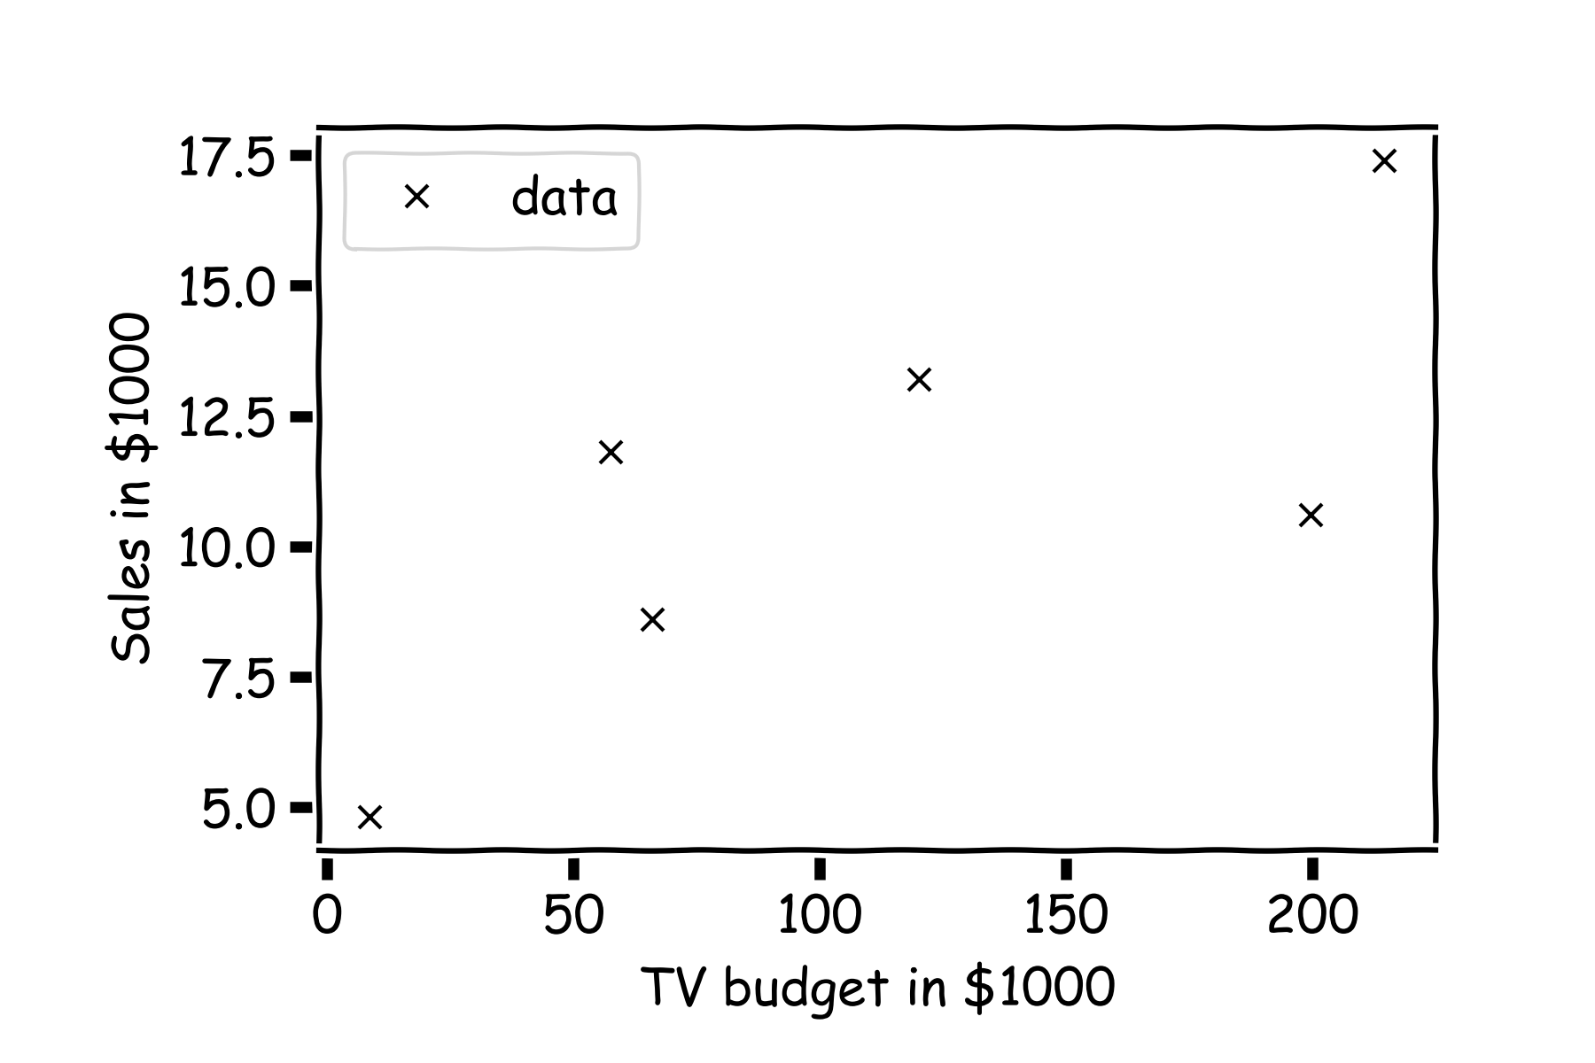
Linear Regression
For a given data set

Slide 8
Linear Regression
Is this line good?

Slide 9
Linear Regression
Maybe this one?

Slide 10
Linear Regression
Or this?

Slide 11
Inference for Linear Regression
First calculate the residuals

Slide 12
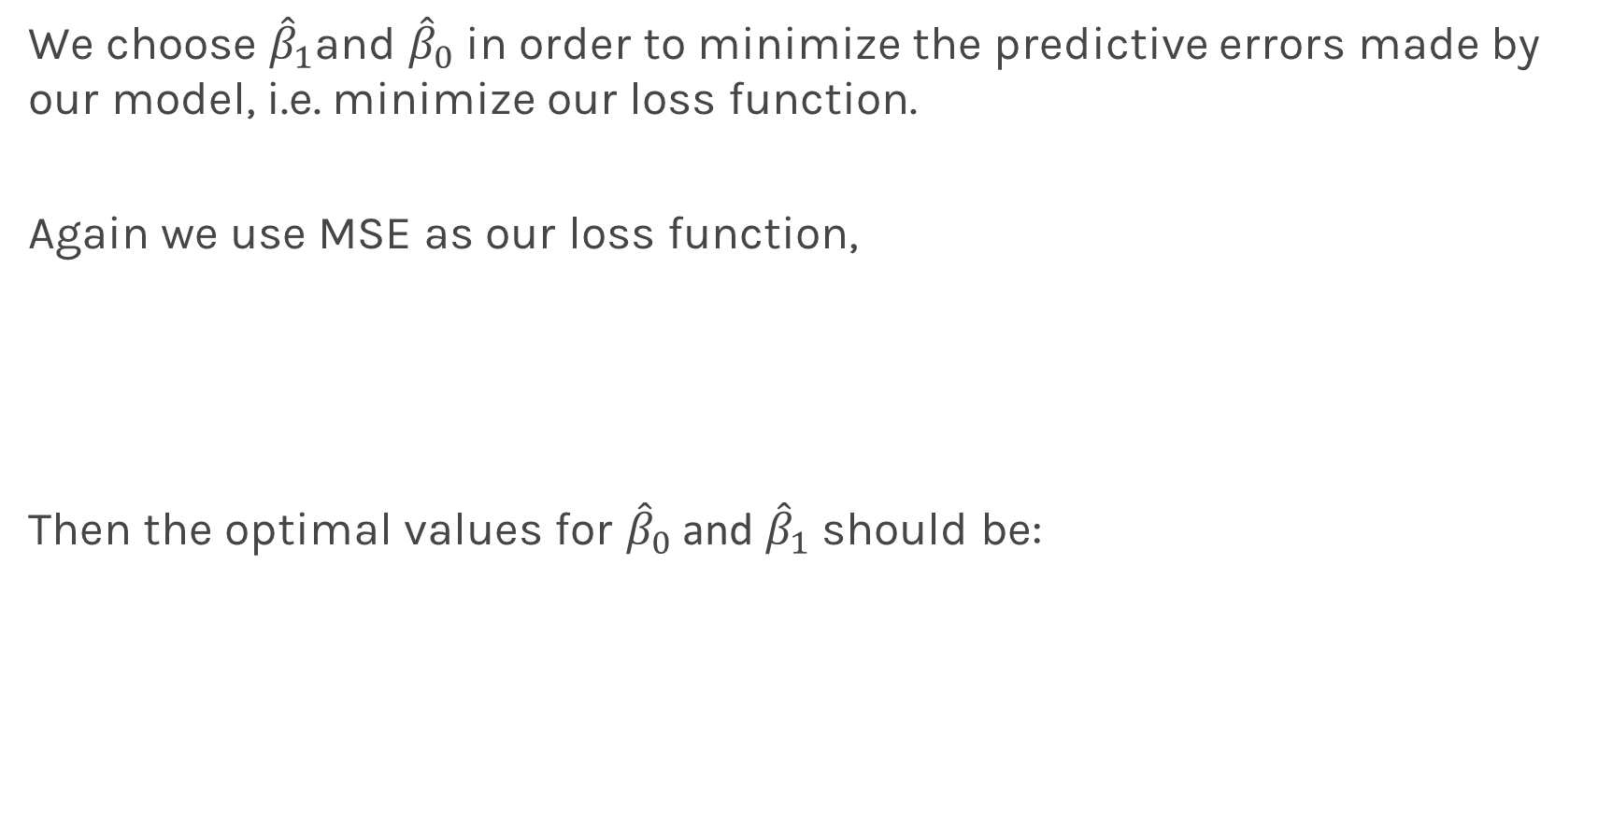
Inference for Linear Regression
We choose ${\hat{β}}_{1}$and ${\hat{β}}_{0}$ in order to minimize the predictive errors made by our model, i.e. minimize our loss function.
Again we use MSE as our loss function,
Then the optimal values for ${\hat{β}}_{0}$ and ${\hat{β}}_{1}$ should be:

Slide 13
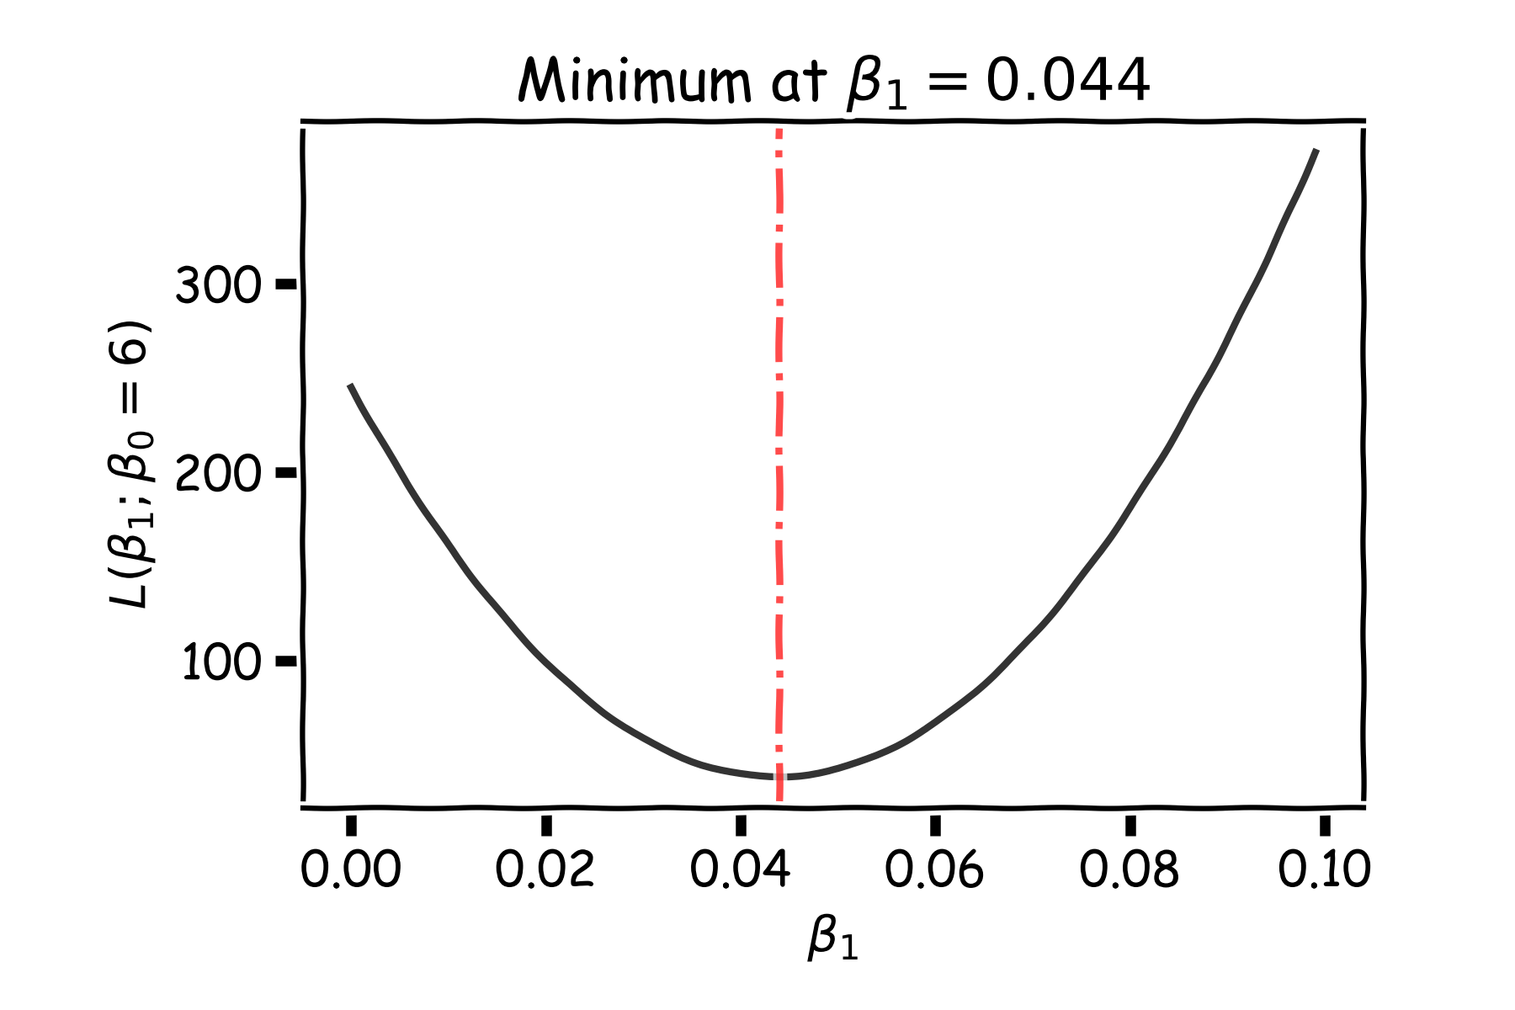
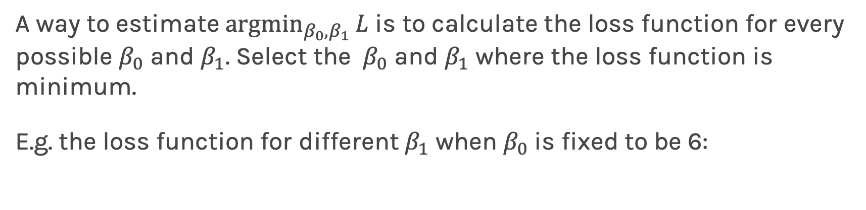
Estimate of the regression coefficients: brute force
A way to estimate ${argmin}_{β_{0},β_{1}}{L}$ is to calculate the loss function for every possible $β_{0}$ and $β_{1}$. Select the $β_{0}$ and $β_{1}$ where the loss function is minimum.
E.g. the loss function for different $β_{1}$ when $β_{0}$is fixed to be 6:
Notes:
Should you mention that this would be a ``numerical’’ approach? (DLS)

Slide 14
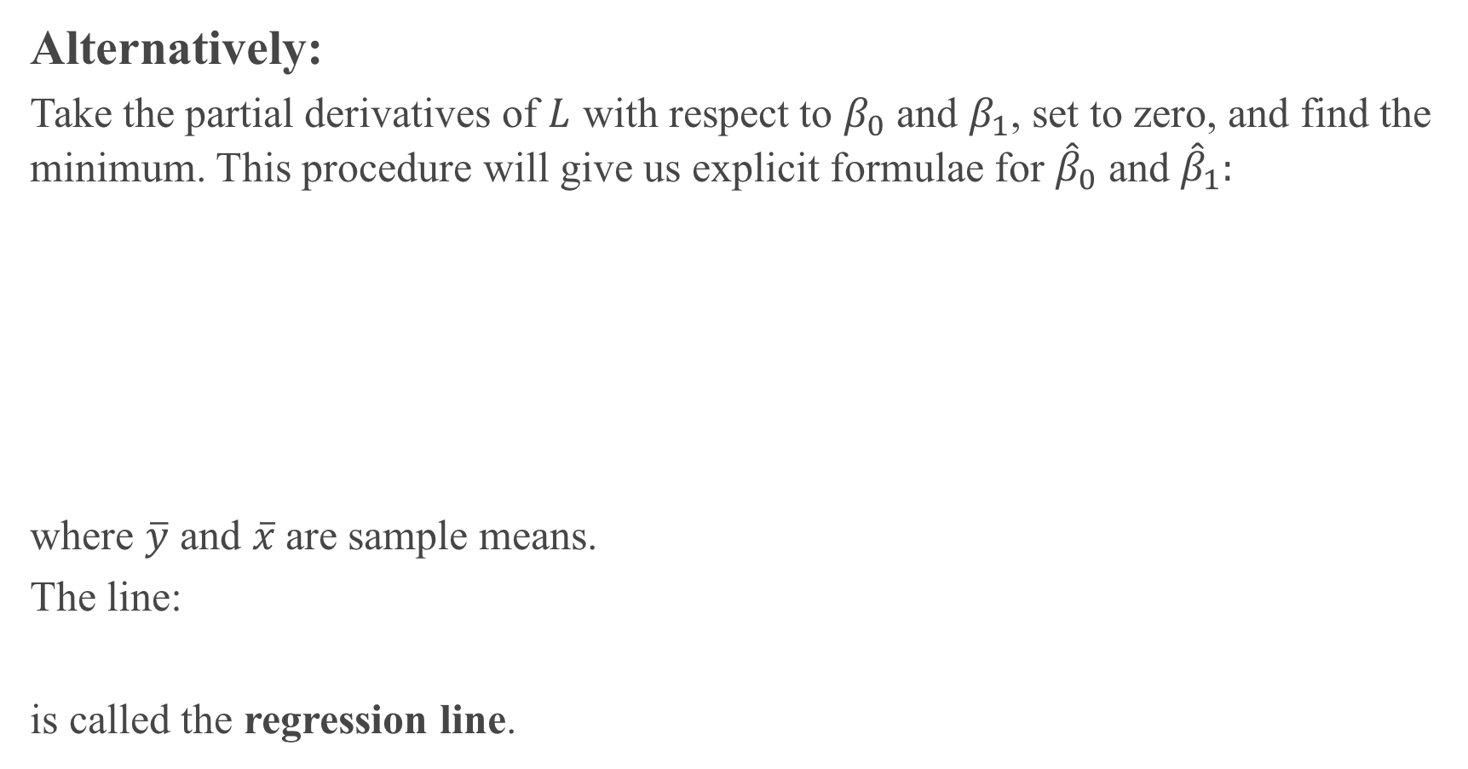
Alternatively:
Take the partial derivatives of $L$ with respect to $β_{0}$ and $β_{1}$, set to zero, and find the minimum. This procedure will give us explicit formulae for ${\hat{β}}_{0}$ and ${\hat{β}}_{1}:$
where $\overline{y}$ and $\overline{x}$are sample means.
The line:
is called the regression line.

Slide 15
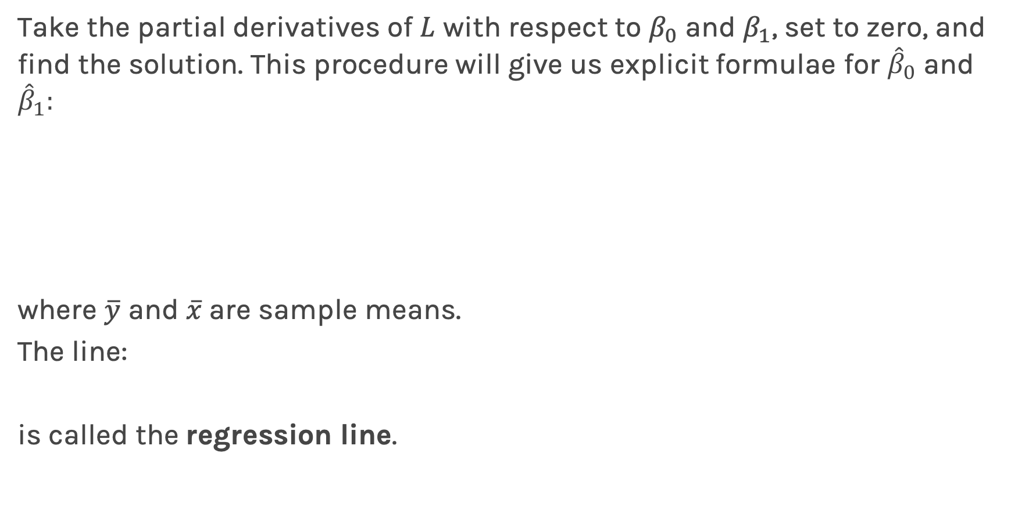
Estimate of the regression coefficients: exact
Take the partial derivatives of $L$ with respect to $β_{0}$ and $β_{1}$, set to zero, and find the solution. This procedure will give us explicit formulae for ${\hat{β}}_{0}$ and ${\hat{β}}_{1}:$
where $\overline{y}$ and $\overline{x}$are sample means.
The line:
is called the regression line.

Slide 17
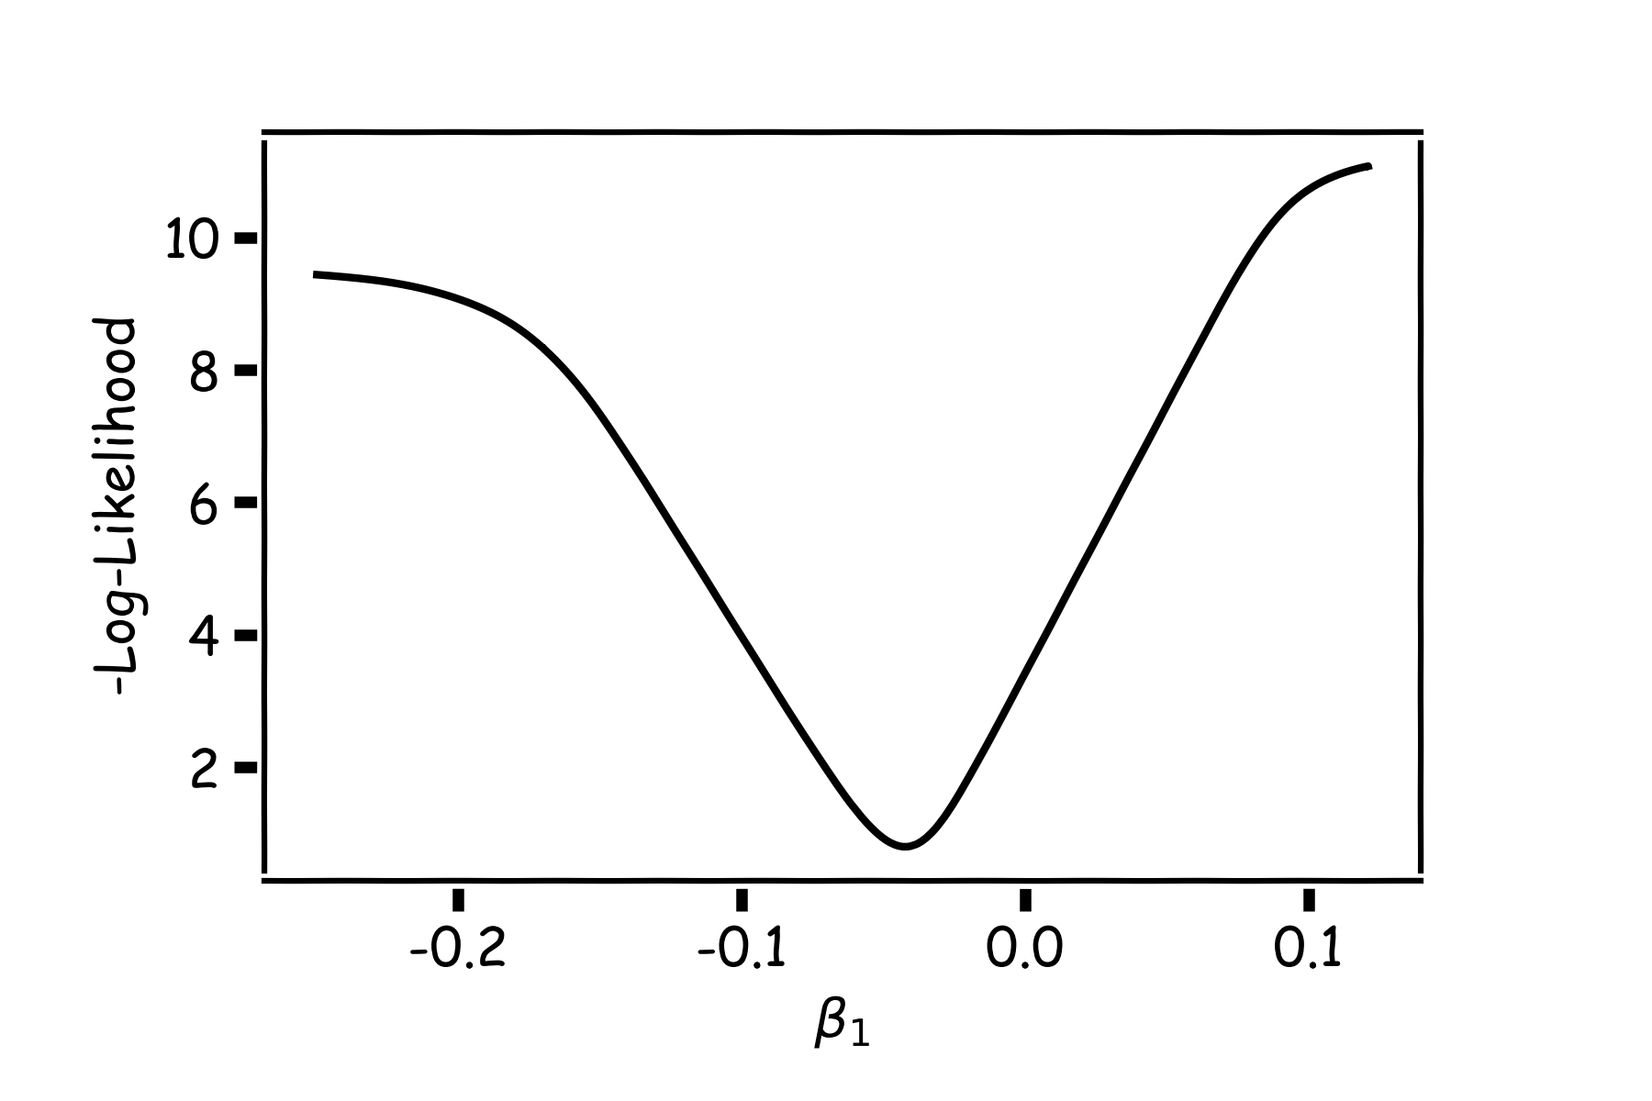
Estimate of the regression coefficients: Gradient Descent
A more flexible method is
Start from any point
Determine which direction to go to reduce the loss (left or right)
Specifically, we can calculate the slope of the function at this point
Shift to the right if slope is negative or shift to the left if slope is positive
Repeat

Slide 18
Estimate of the regression coefficients: Gradient Descent
If the step is proportional to the slope then you avoid overshooting the minimum.
Question: What is the mathematical function that describes the slope?
Question: How do we generalize this to more than one predictor?
Question: What do you think it is a good approach for telling the model how to change (what is the step size) to become better?
Notes:
S

Slide 19
Estimate of the regression coefficients: Gradient Descent
If the step is proportional to the slope then you avoid overshooting the minimum.
Question: What is the mathematical function that describes the slope? Derivative
Question: How do we generalize this to more than one predictor?
Take the derivative with respect to each coefficient and do the same sequentially
Question: What do you think it is a good approach for telling the model how to change (what is the step size) to become better?
More on this later

Slide 20
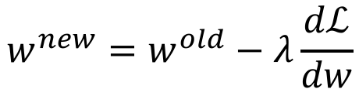
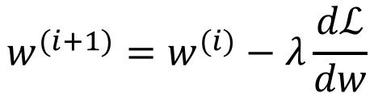
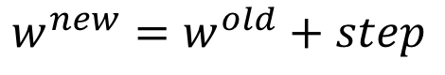
Estimate of the regression coefficients: Gradient Descent
We know that we want to go in the opposite direction of the derivative and we know we want to be making a step proportionally to the derivative.
Making a step means:
Learning Rate
$${w^{new}=w}^{old}+step$$
Opposite direction of the derivative means:
$${w^{new}=w}^{old}−λ\frac{dℒ}{dw}$$
Change to more conventional notation:
$${w^{(i+1)}=w}^{(i)}−λ\frac{dℒ}{dw}$$

Slide 21
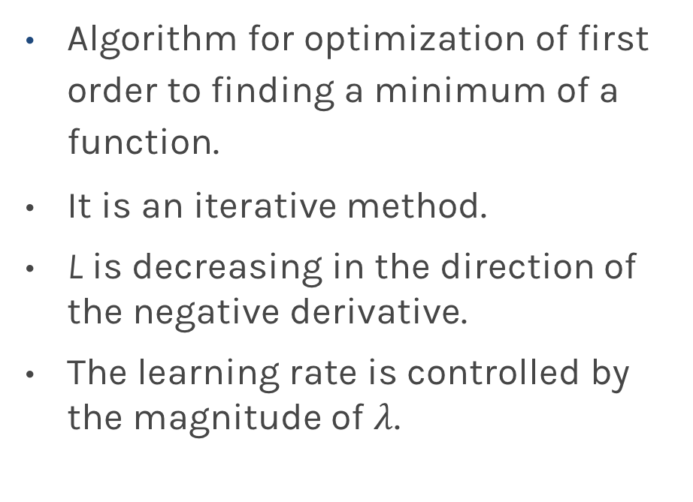
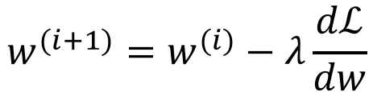
Estimate of the regression coefficients: Gradient Descent
Algorithm for optimization of first order to finding a minimum of a function.
It is an iterative method.
L is decreasing in the direction of the negative derivative.
The learning rate is controlled by the magnitude of $λ$.
$${w^{(i+1)}=w}^{(i)}−λ\frac{dℒ}{dw}$$
L
-
+
w

Slide 22
Gradient Descent: Considerations (cont)
We still need to derive the derivatives.
We need to know what is the learning rate or how to set it.
We need to avoid local minima.
Finally, the full loss function includes summing up all individual ‘errors’. Unless you are a statistician, this can be hundreds of thousands of examples.

Slide 23
Gradient Descent: Considerations (cont)
We still need to derive the derivatives.
We need to know what is the learning rate or how to set it.
We need to avoid local minima.
Finally, the full likelihood function includes summing up all individual ‘errors’. Unless you are a statistician, this can be hundreds of thousands of examples.

Slide 24
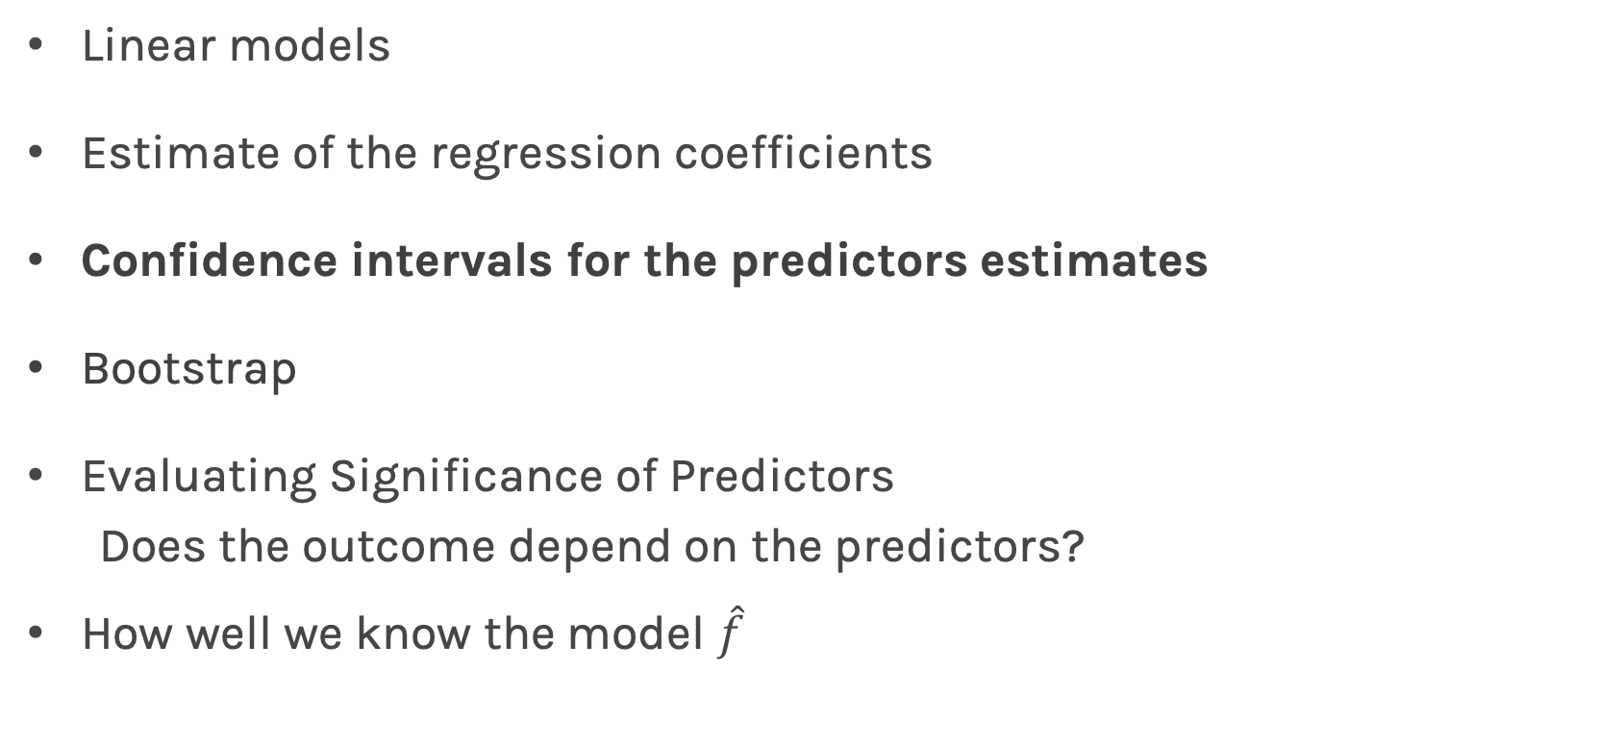
Lecture Outline
Linear models
Estimate of the regression coefficients
Confidence intervals for the predictors estimates
Bootstrap
Evaluating Significance of Predictors
Does the outcome depend on the predictors?
How well we know the model $\hat{f}$

Slide 25
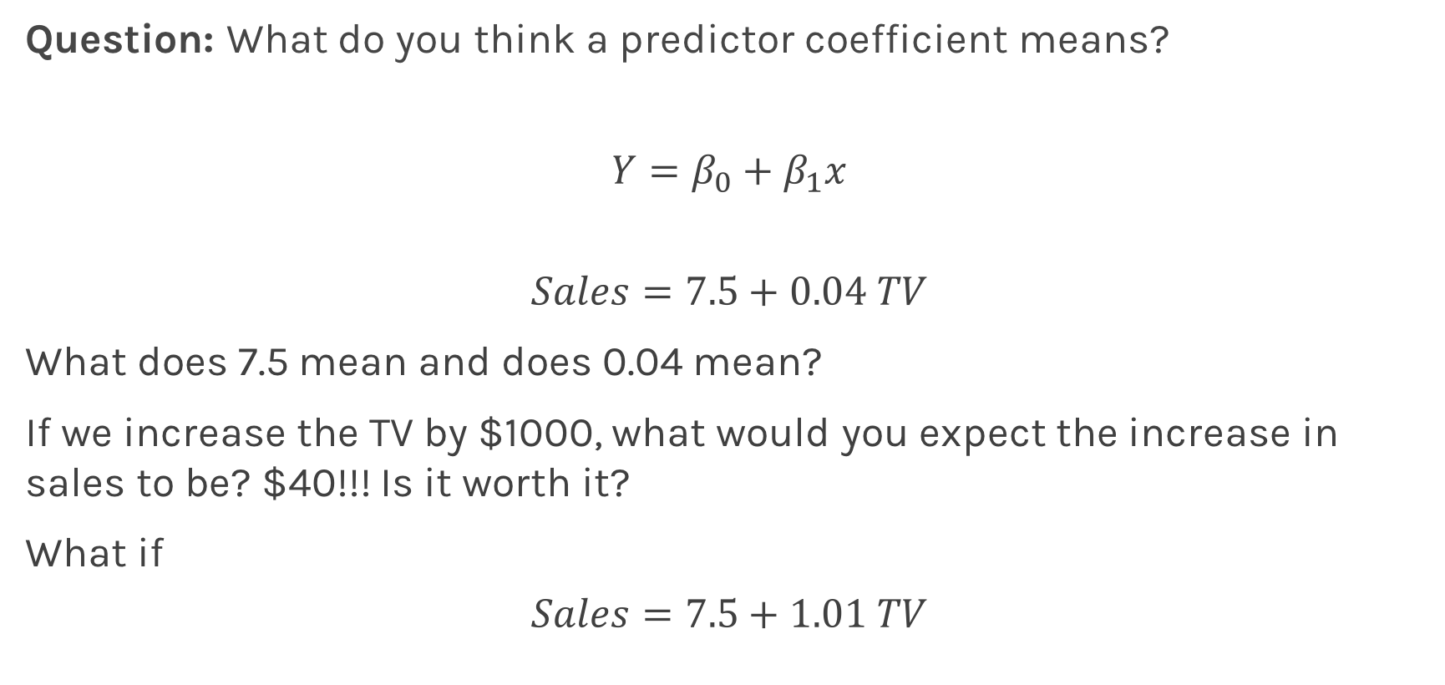
Interpretation of Predictors
Question: What do you think a predictor coefficient means?
$$Y=β_{0}+β_{1}x$$
$$Sales=7.5+0.04 TV$$
What does 7.5 mean and does 0.04 mean?
If we increase the TV by $1000, what would you expect the increase in sales to be? $40!!! Is it worth it?
What if
$$Sales=7.5+1.01 TV$$
Notes:
Axes labels! (DLS)

Slide 26
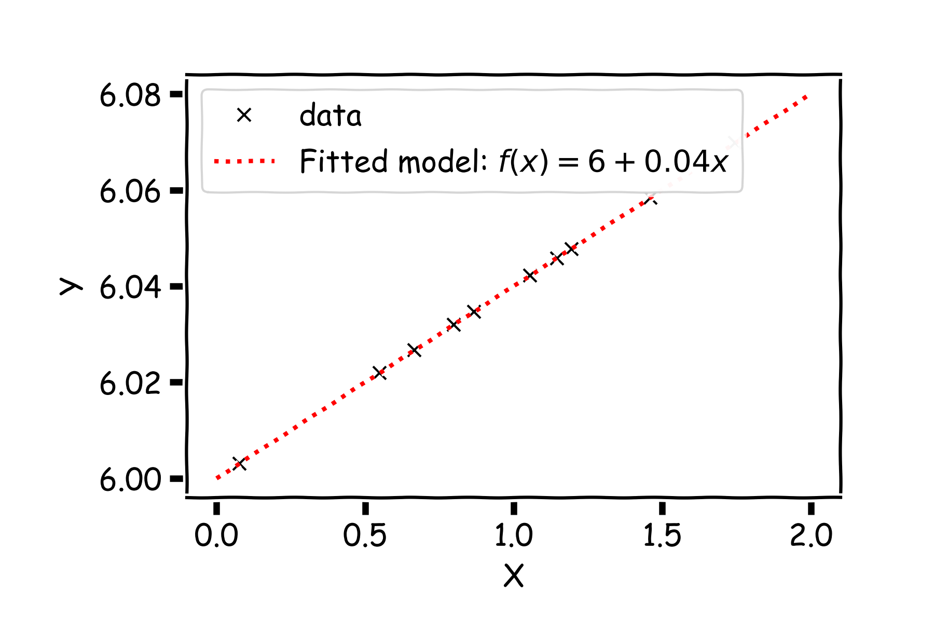
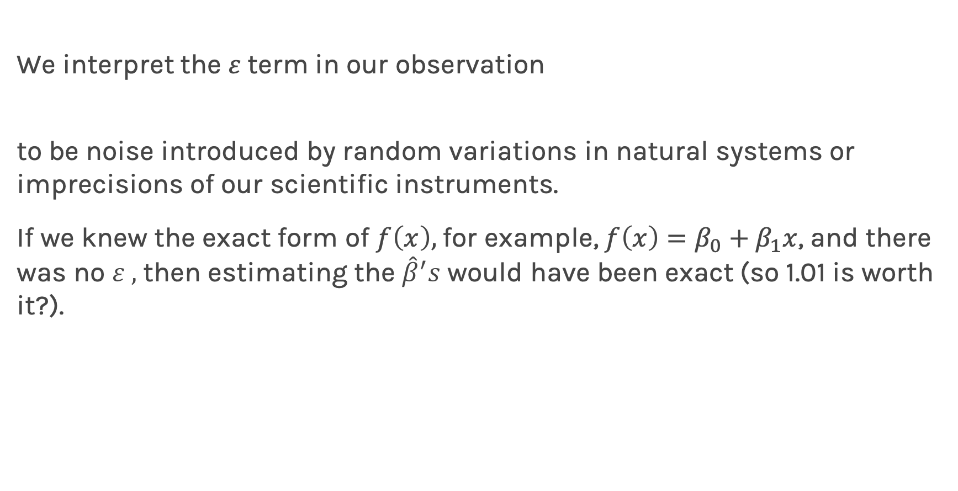
Confidence intervals for the predictors estimates
We interpret the $ε$term in our observation
to be noise introduced by random variations in natural systems or imprecisions of our scientific instruments.
If we knew the exact form of $f\left(x\right),$for example, $f\left(x\right)=β_{0}+β_{1}x$, and there was no $ε ,$ then estimating the ${\hat{β}}^{′}s$ would have been exact (so 1.01 is worth it?).
Notes:
Axes labels! (DLS)

Slide 27
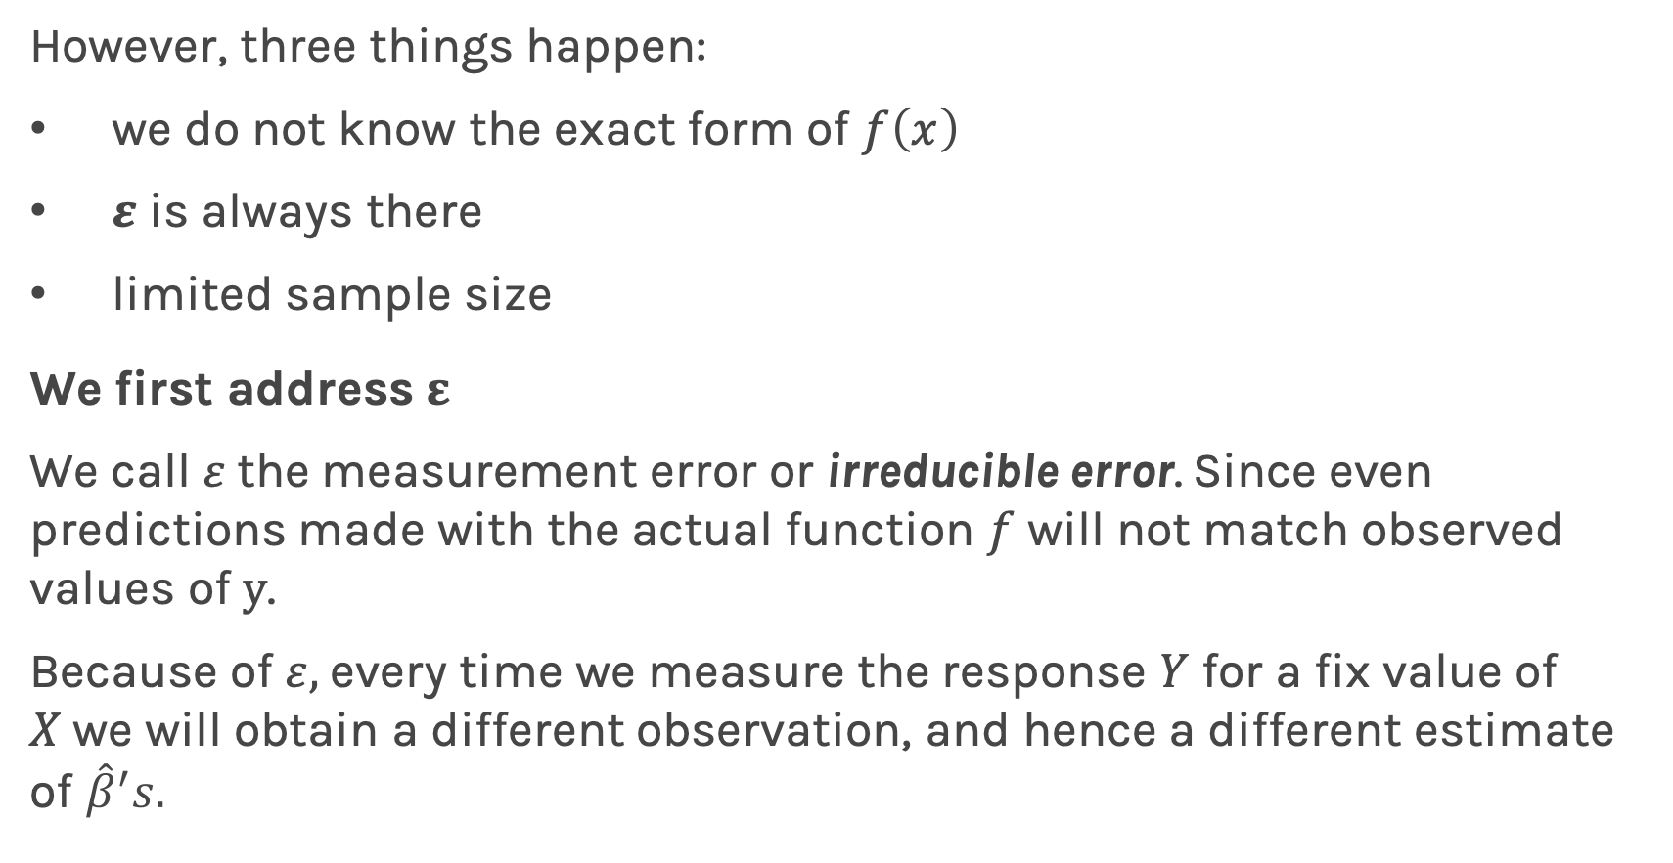
Confidence intervals for the predictors estimates (cont)
However, three things happen:
we do not know the exact form of $f\left(x\right)$
$ε$ is always there
limited sample size
We first address $ε$
We call $ε$the measurement error or irreducible error. Since even predictions made with the actual function $f$ will not match observed values of $y$.
Because of $ε,$ every time we measure the response $Y$ for a fix value of $X$we will obtain a different observation, and hence a different estimate of ${\hat{β}}^{′}s.$

Slide 28
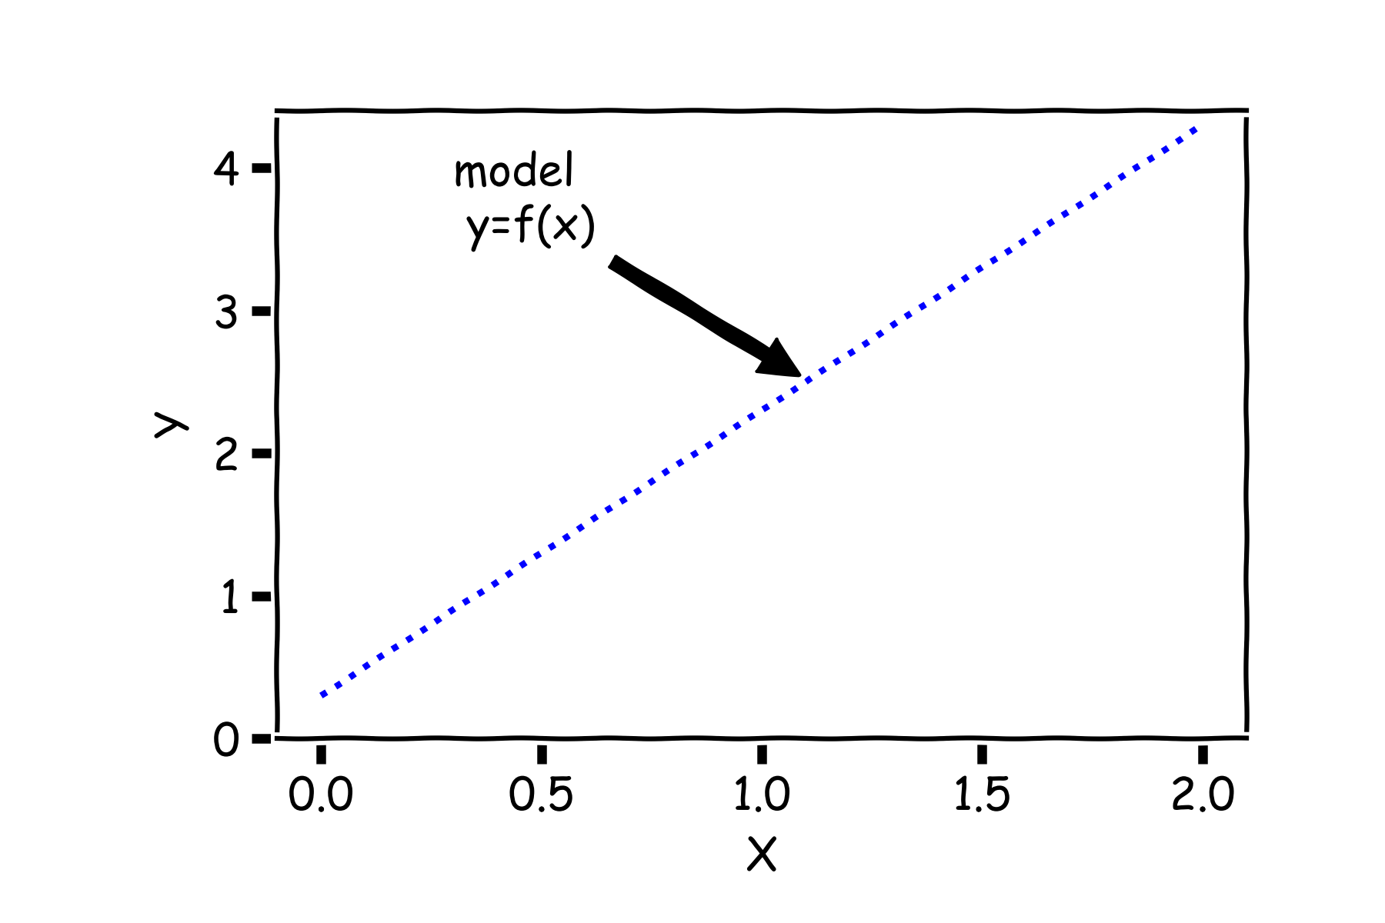
Confidence intervals for the predictors estimates (cont)
Start with a model

Slide 29
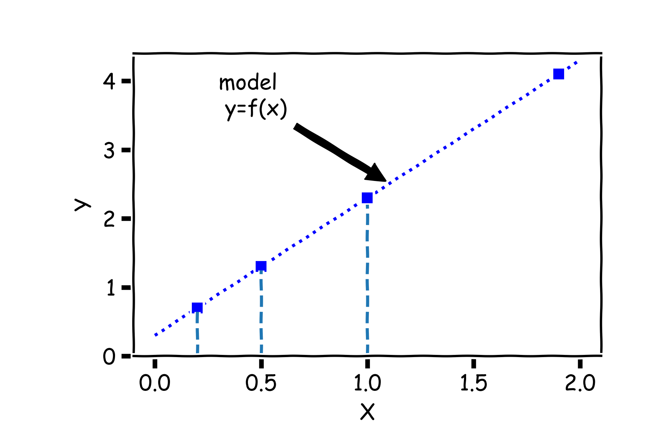
Confidence intervals for the predictors estimates (cont)
For a some values of $X,$ $Y=f(X)$

Slide 30
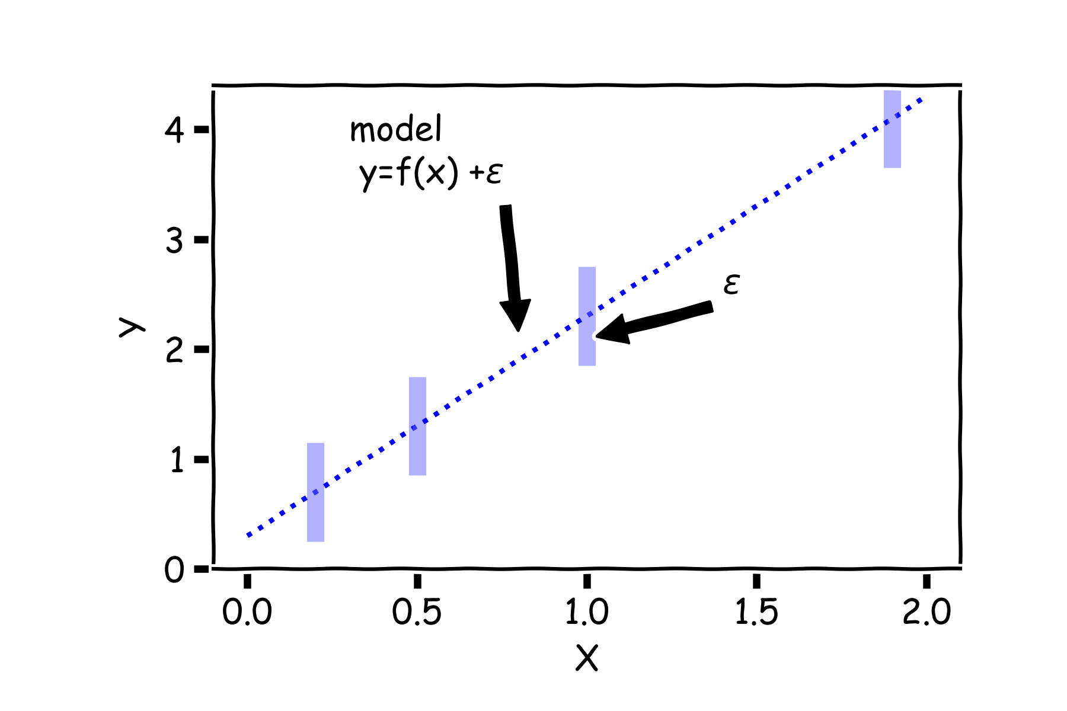
Confidence intervals for the predictors estimates (cont)
But due to error, every time we measure the response Y for a fixed value of X we will obtain a different observation.

Slide 31
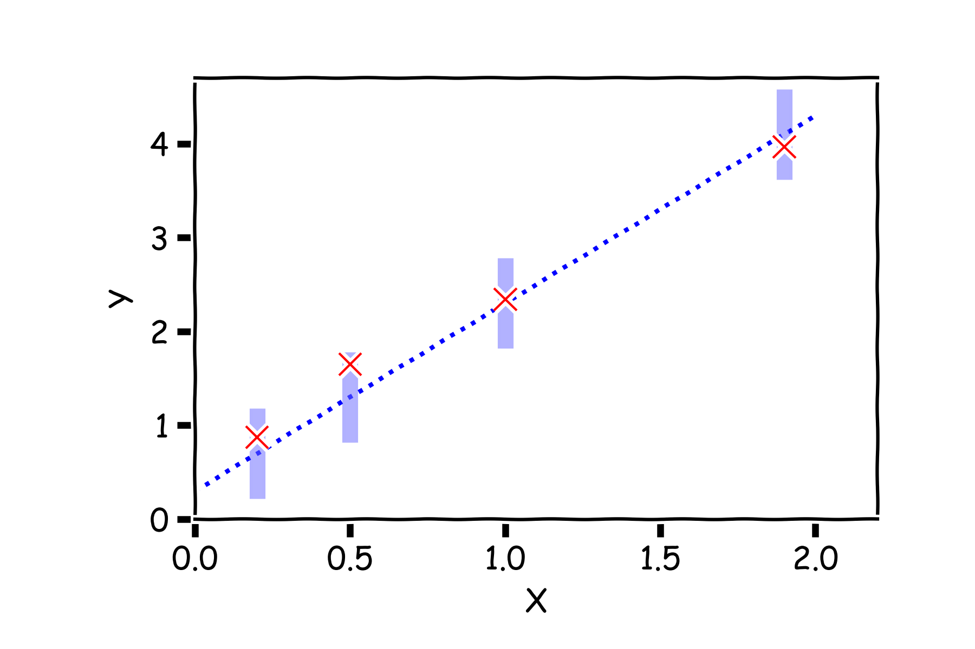
Confidence intervals for the predictors estimates (cont)
One set of observations, “one realization” we obtain one set of Ys (red crosses).

Slide 32
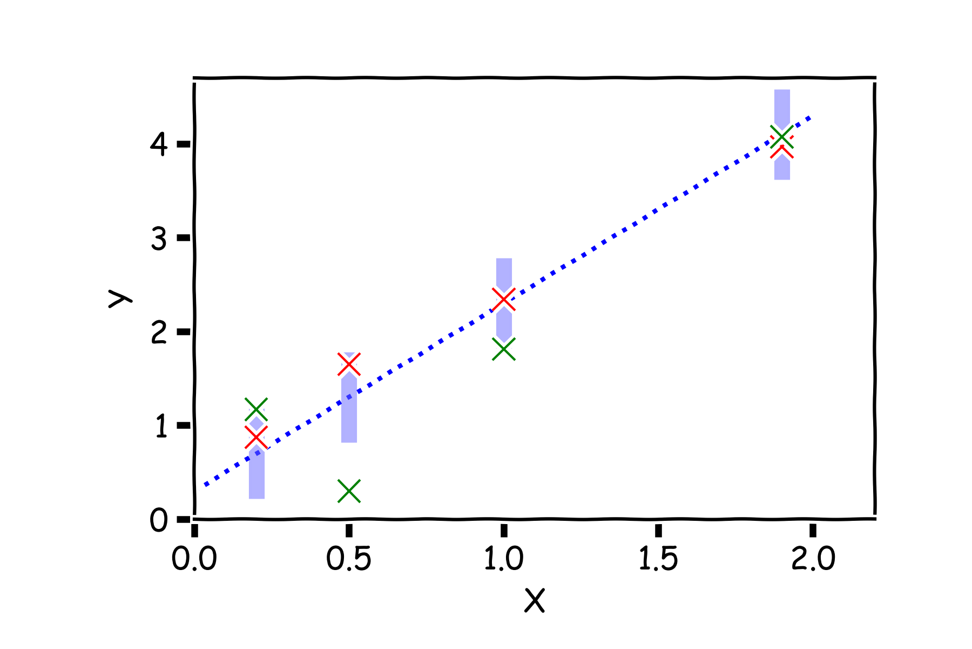
Confidence intervals for the predictors estimates (cont)
Another set of observations, “another realization” we obtain another set of Ys (green crosses).

Slide 33
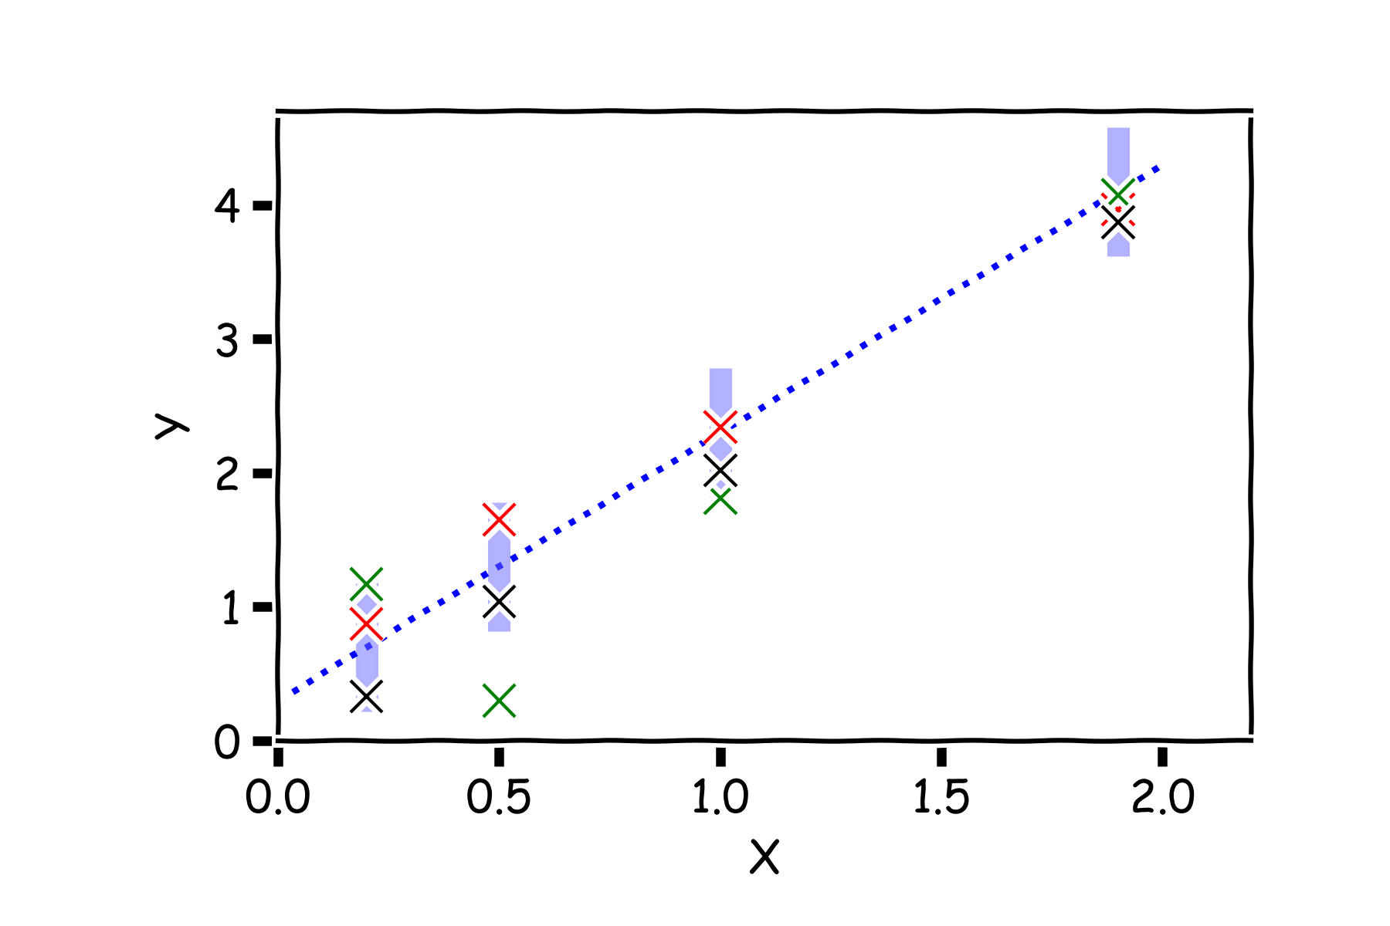
Confidence intervals for the predictors estimates (cont)
Another set of observations, “another realization” we obtain another set of Ys (black crosses).

Slide 34
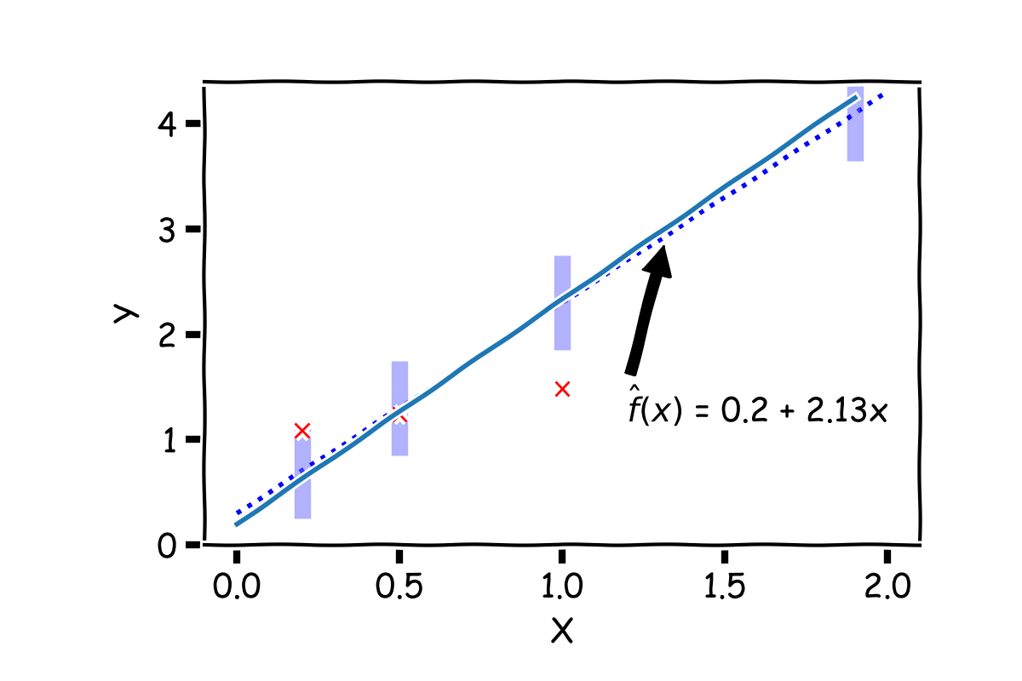
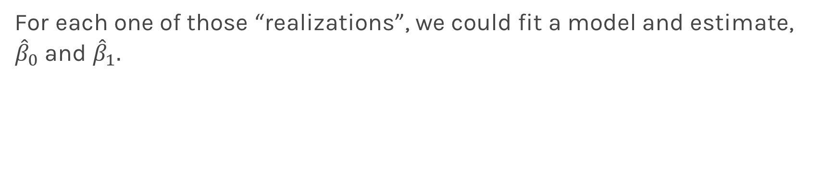
Confidence intervals for the predictors estimates (cont)
For each one of those “realizations”, we could fit a model and estimate, ${\hat{β}}_{0}$ and ${\hat{β}}_{1}.$

Slide 35
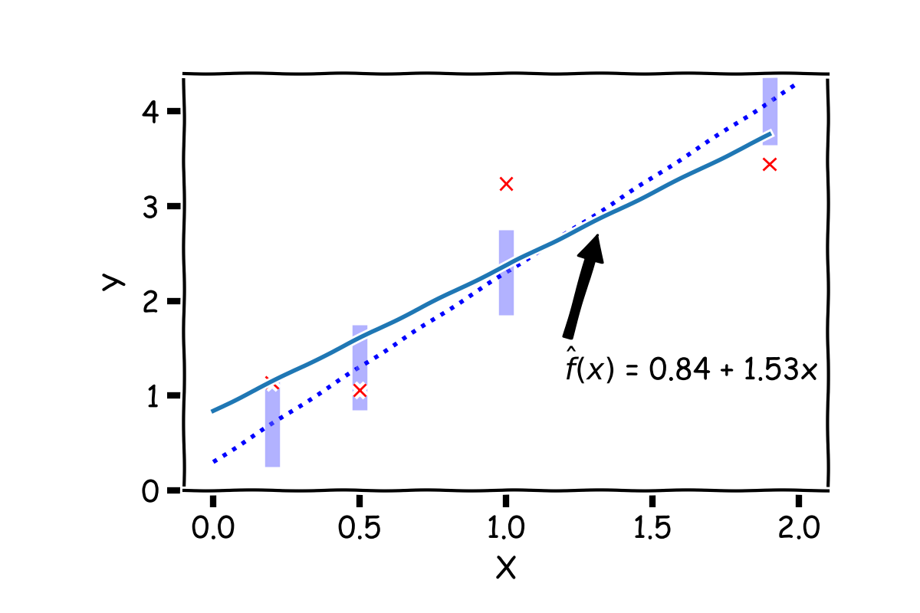
Confidence intervals for the predictors estimates (cont)
For each one of those “realizations”, we could fit a model and estimate, ${\hat{β}}_{0}$ and ${\hat{β}}_{1}.$

Slide 36
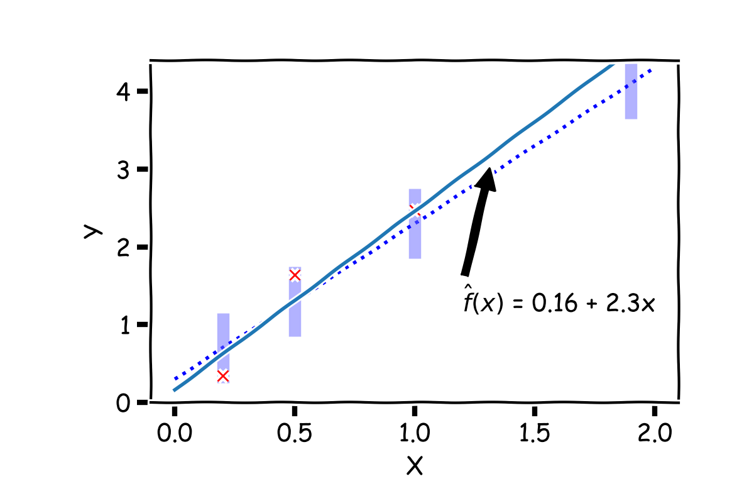
Confidence intervals for the predictors estimates (cont)
For each one of those “realizations”, we could fit a model and estimate, ${\hat{β}}_{0}$ and ${\hat{β}}_{1}.$

Slide 37
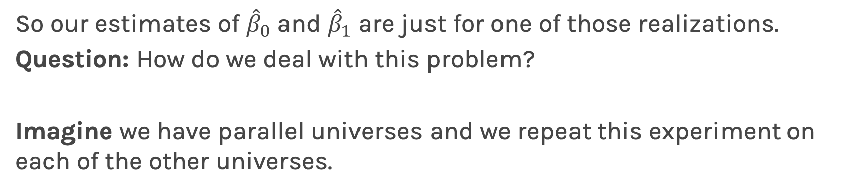
Confidence intervals for the predictors estimates (cont)
So our estimates of ${\hat{β}}_{0}$ and ${\hat{β}}_{1}$ are just for one of those realizations.
Question: How do we deal with this problem?
Imagine we have parallel universes and we repeat this experiment on each of the other universes.
Notes:
Gabriel García Márquez, whose novel One Hundred Years of Solitude … magic realism.

Slide 38
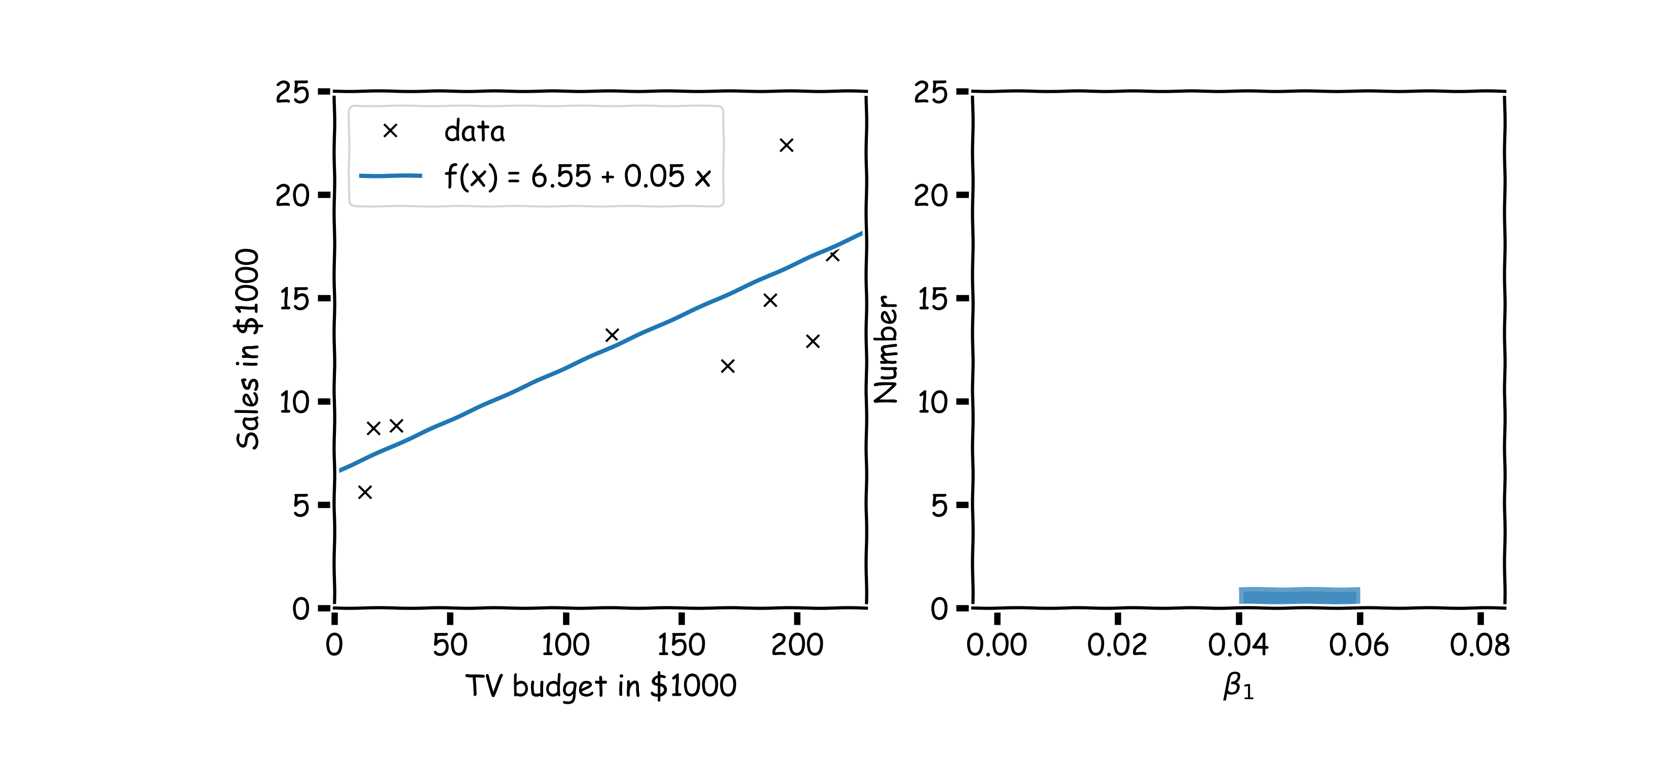
Confidence intervals for the predictors estimates (cont)
$$.$$
In our magical realism, we can now sample multiple times.

Slide 39
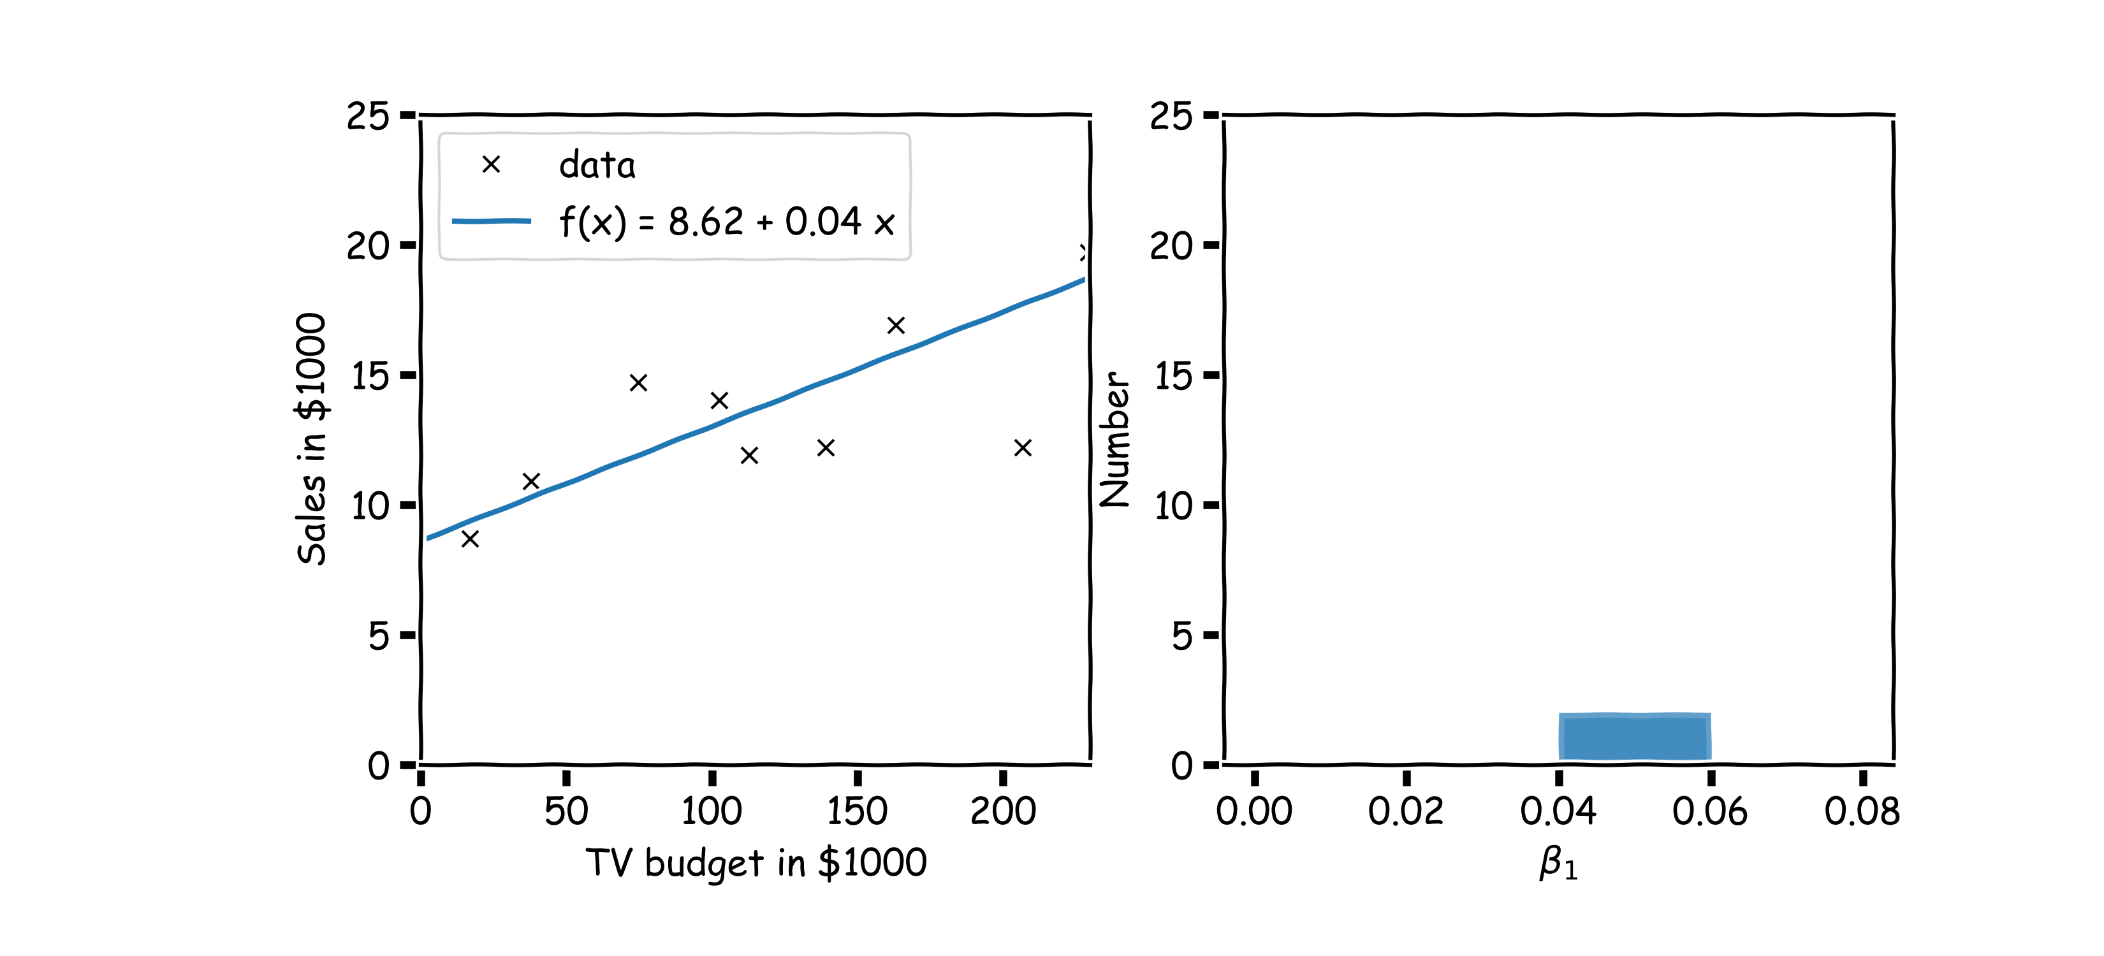
Confidence intervals for the predictors estimates (cont)
Another sample.

Slide 40
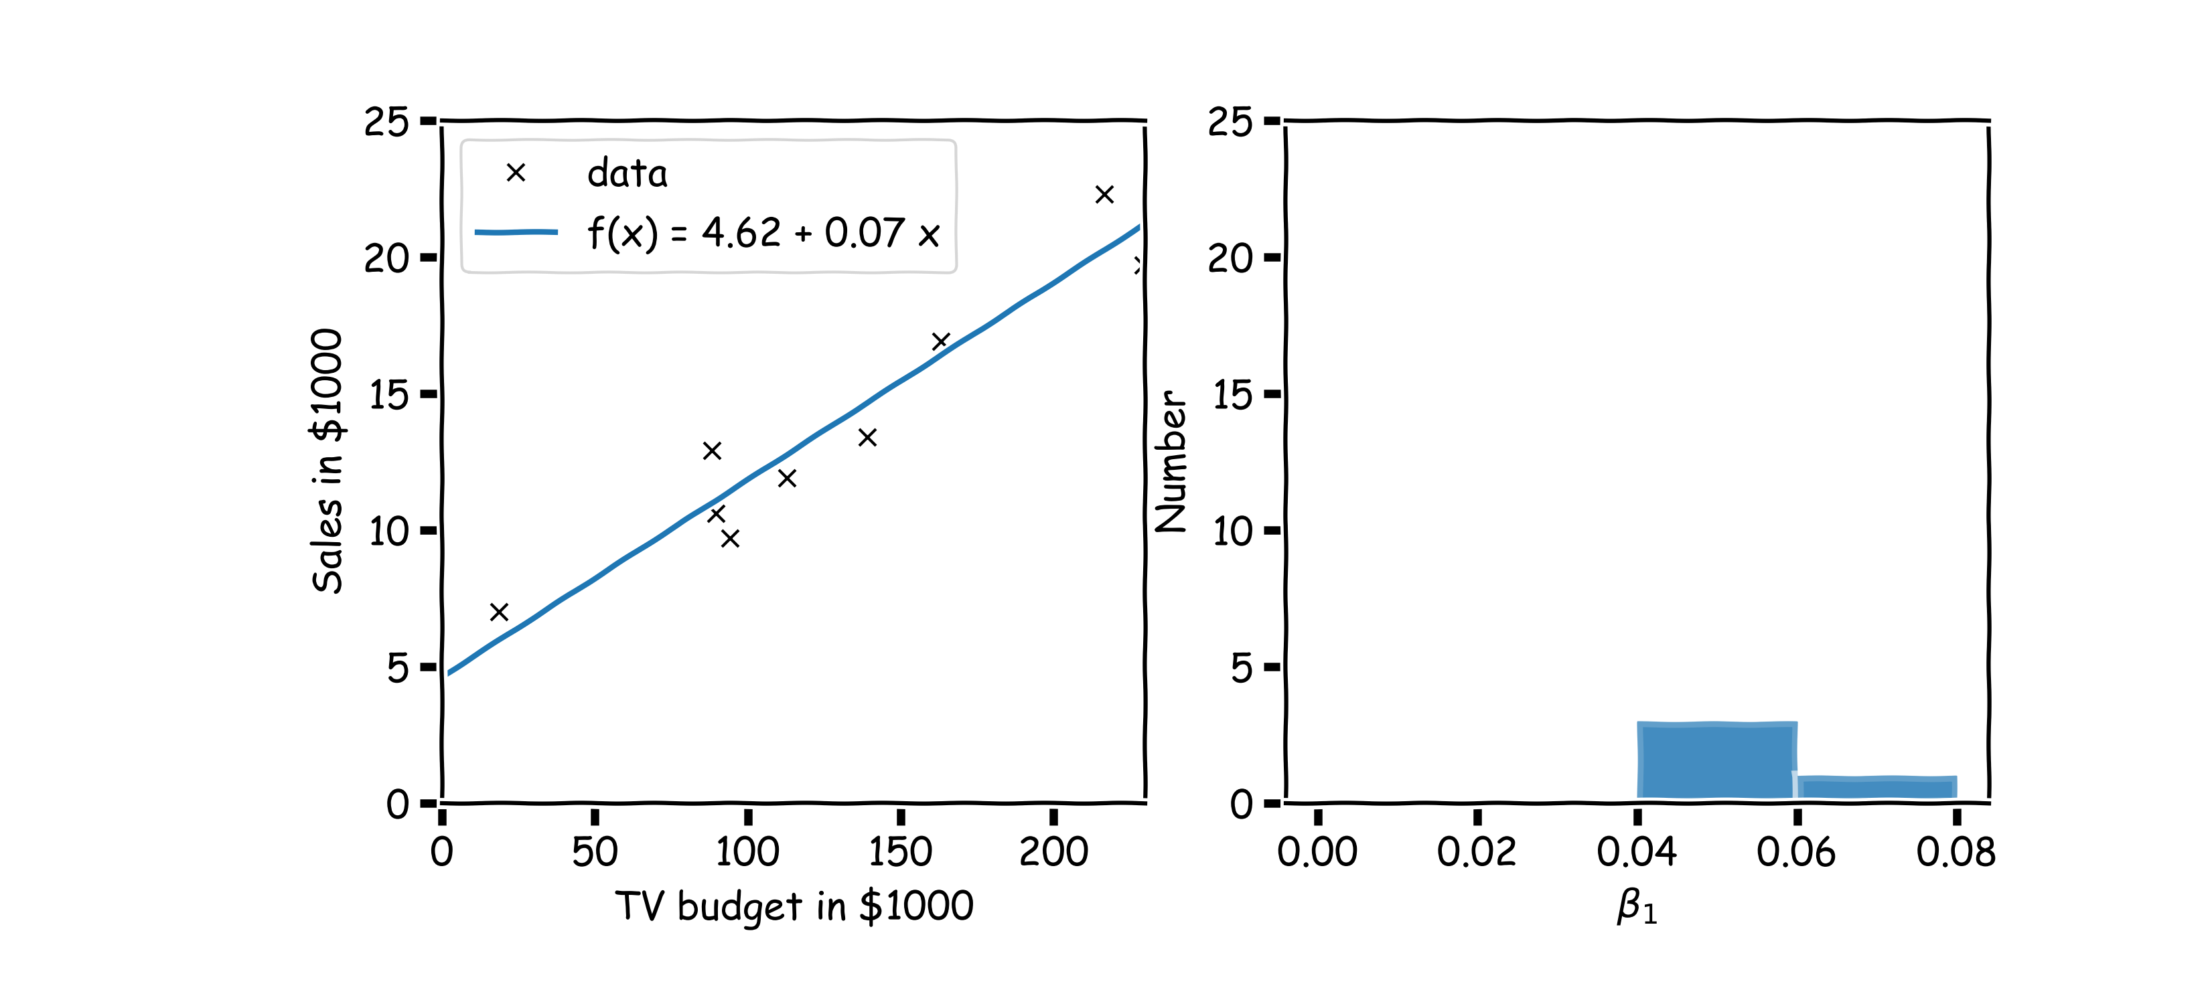
Confidence intervals for the predictors estimates (cont)
Another sample.

Slide 41
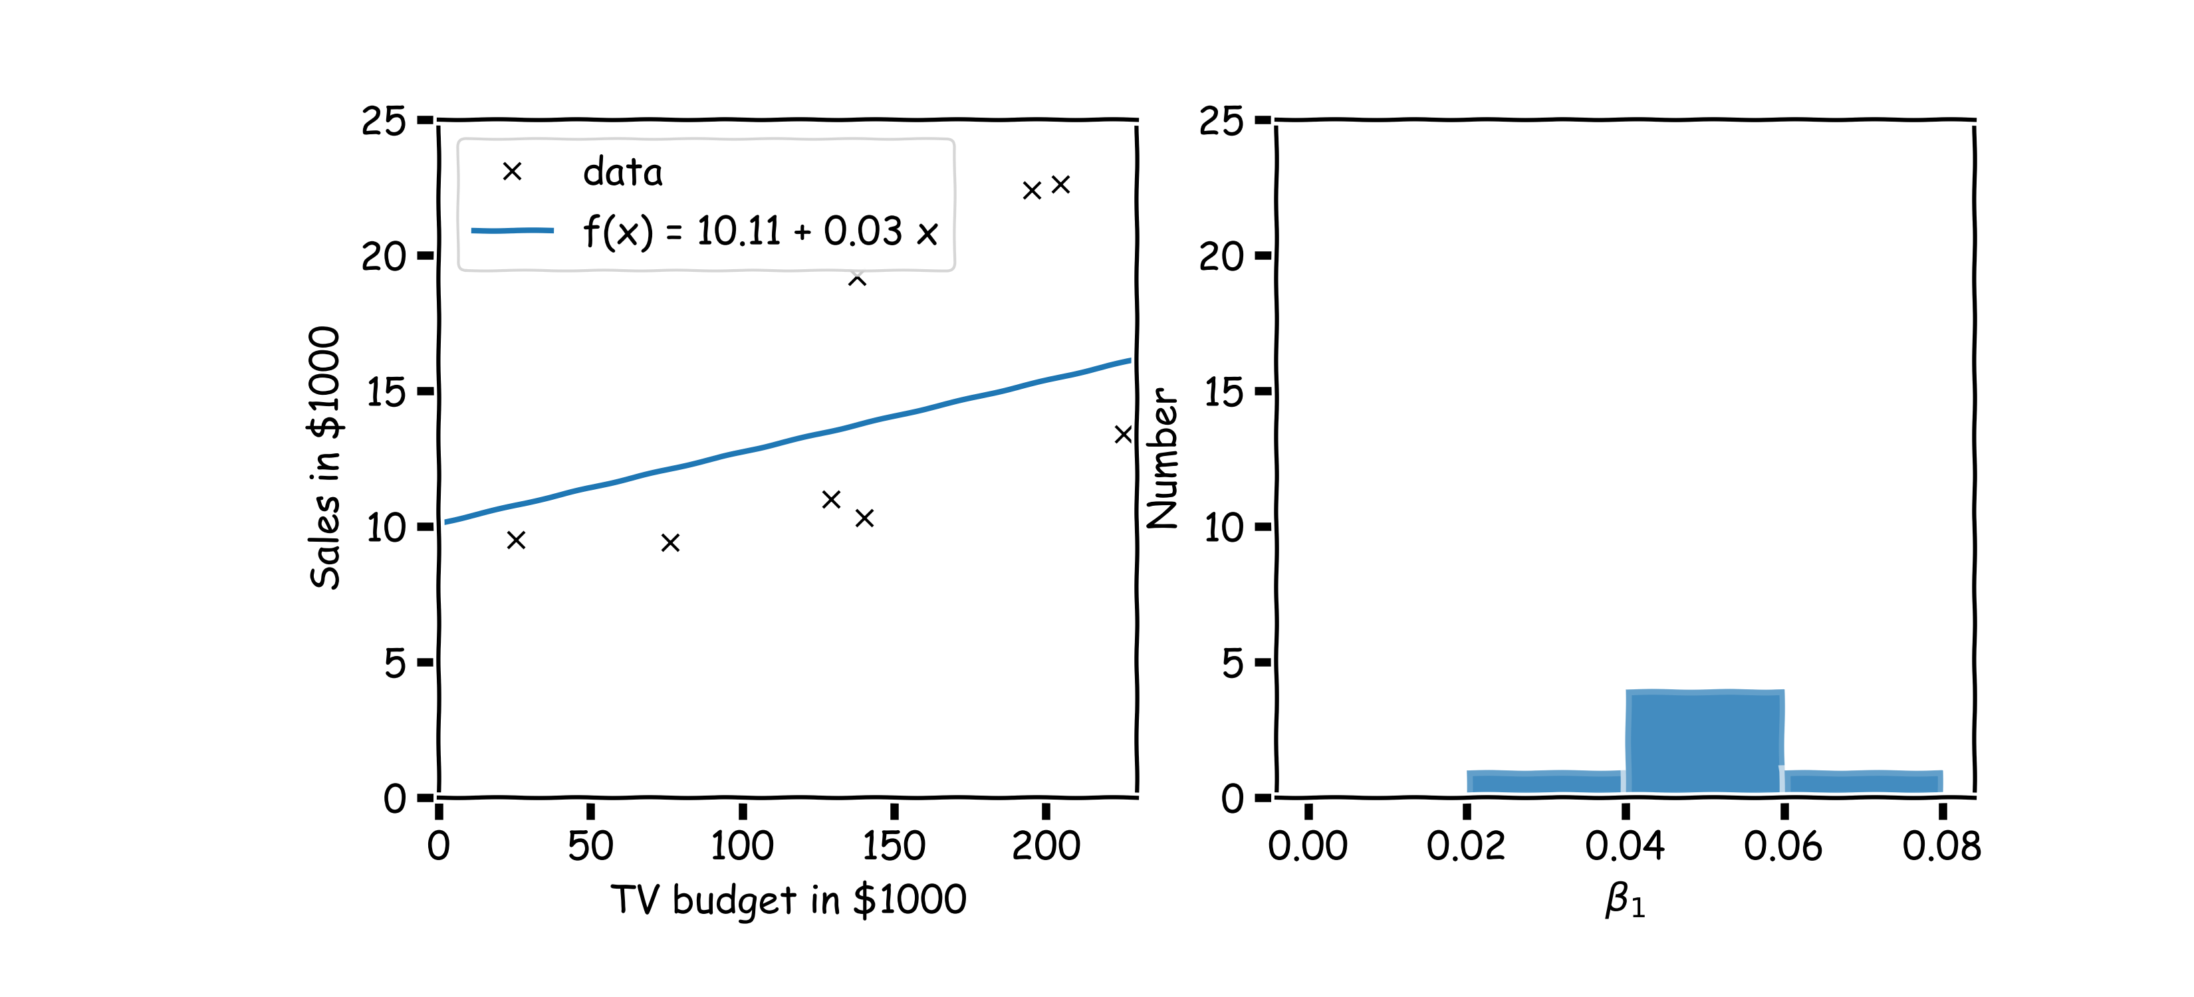
Confidence intervals for the predictors estimates (cont)
And another sample.

Slide 42
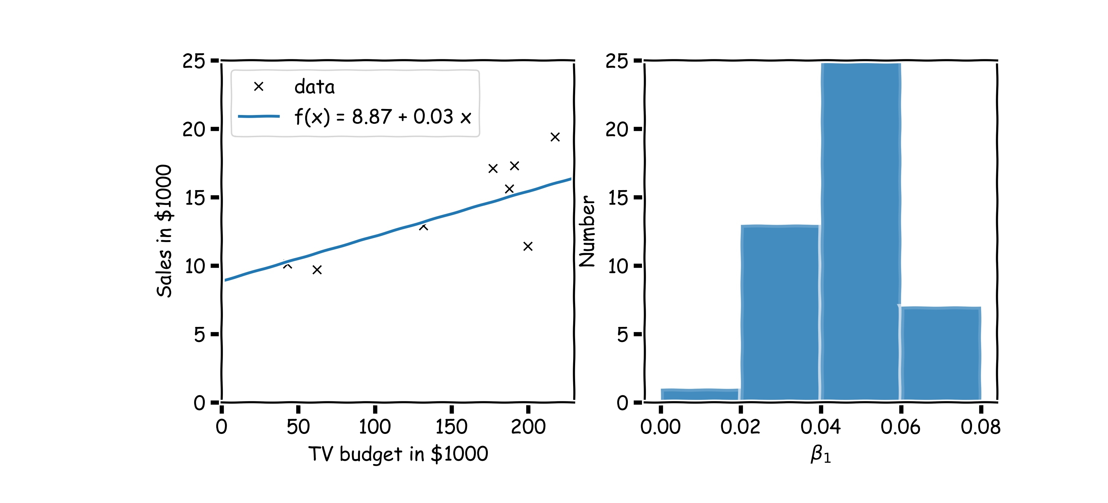
Confidence intervals for the predictors estimates (cont)
Repeat this for 100 times.

Slide 43
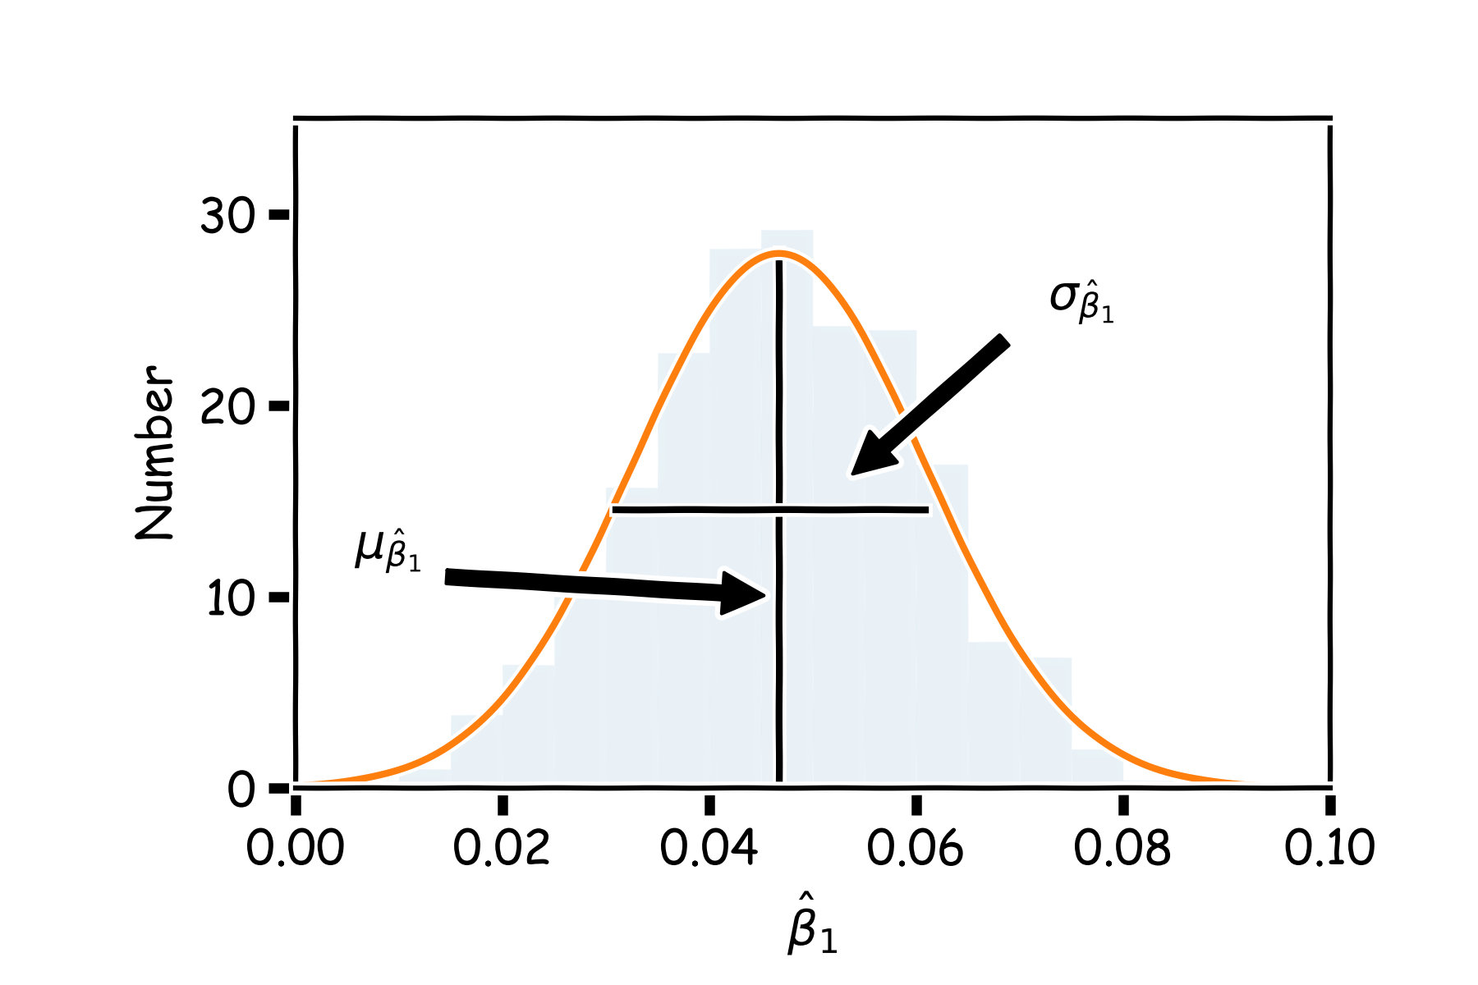
Confidence intervals for the predictors estimates (cont)
We can estimate the mean and standard deviation of all the estimates ${\hat{β}}_{1}$.

Slide 44
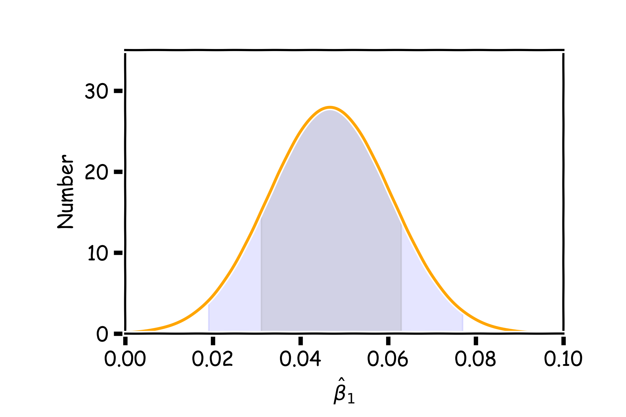
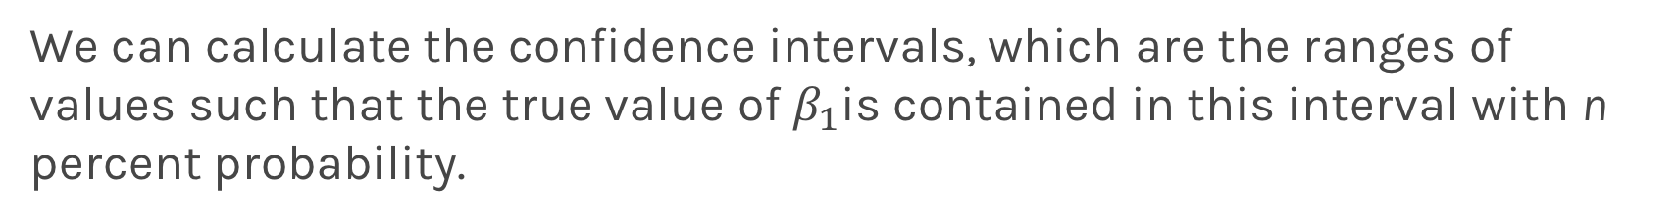
Confidence intervals for the predictors estimates (cont)
We can calculate the confidence intervals, which are the ranges of values such that the true value of $β_{1}$is contained in this interval with n percent probability.
95%
68%

Slide 45
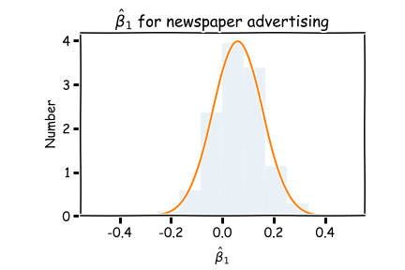
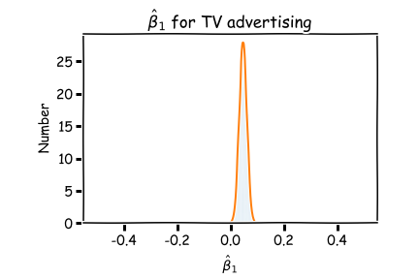
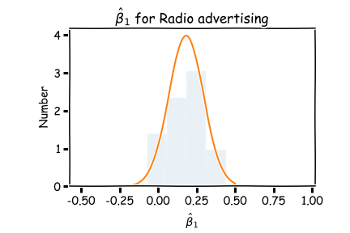
Now we can answer the question, ’how significant are the predictors?’ Here we show the same analysis for all three predictors.
Question: Which ones are important?

Slide 46

Lecture Outline
Linear models
Estimate of the regression coefficients
Confidence intervals for the predictors estimates
Bootstrap
Evaluating Significance of Predictors
Does the outcome depend on the predictors?
How well we know the model $\hat{f}$

Slide 47
Bootstrap
Imagine we have 5 billiard balls in a bucket.

Slide 48
Bootstrap
We first pick randomly a ball and replicate it. This is called sampling with replacement.
We move the replicated ball to another bucket.

Slide 49
Bootstrap

Slide 50
Bootstrap
We then pick randomly another ball and again we replicate it.
Again, we then move the replicated ball to the other bucket.

Slide 51
Bootstrap

Slide 52
Bootstrap
We repeat this process.
Notes:
Fix this with true replacement

Slide 53
Bootstrap
Again

Slide 54
Bootstrap
And again

Slide 55
Bootstrap
Until the other bucket has the same number of balls as the original one.

Slide 56
Bootstrap
We repeat the same process and acquire another sample

Slide 57
Bootstrap
We repeat the same process and acquire another sample

Slide 58
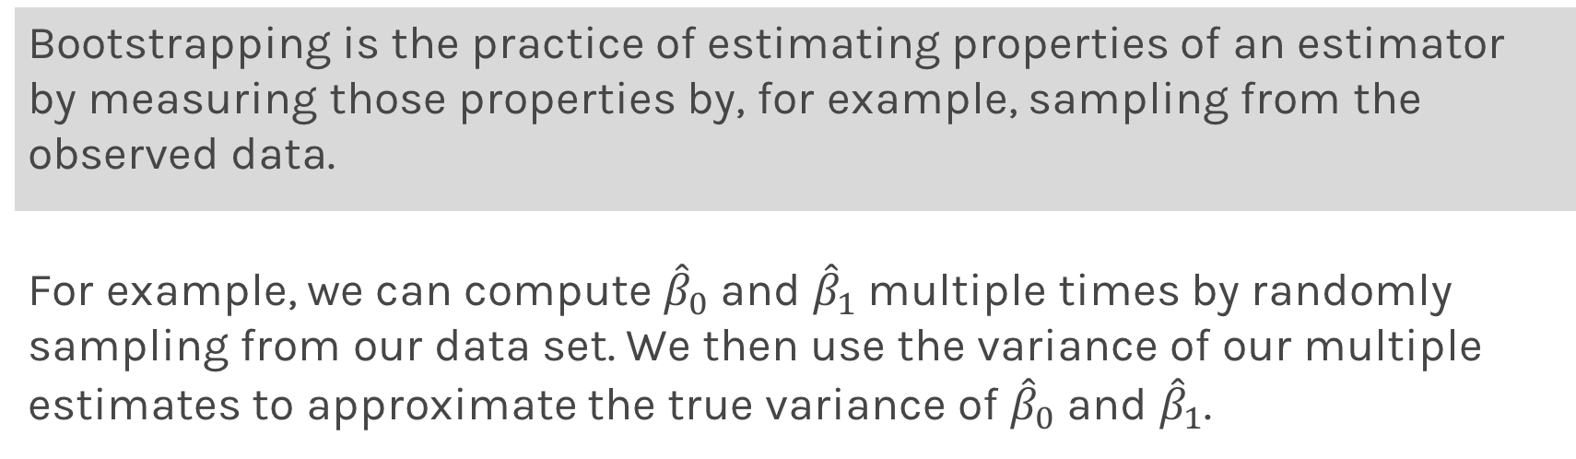
Bootstrapping for Estimating Sampling Error
Definition
Bootstrapping is the practice of estimating properties of an estimator by measuring those properties by, for example, sampling from the observed data.
For example, we can compute ${\hat{β}}_{0}$ and ${\hat{β}}_{1}$multiple times by randomly sampling from our data set. We then use the variance of our multiple estimates to approximate the true variance of ${\hat{β}}_{0}$ and ${\hat{β}}_{1}$.

Slide 59
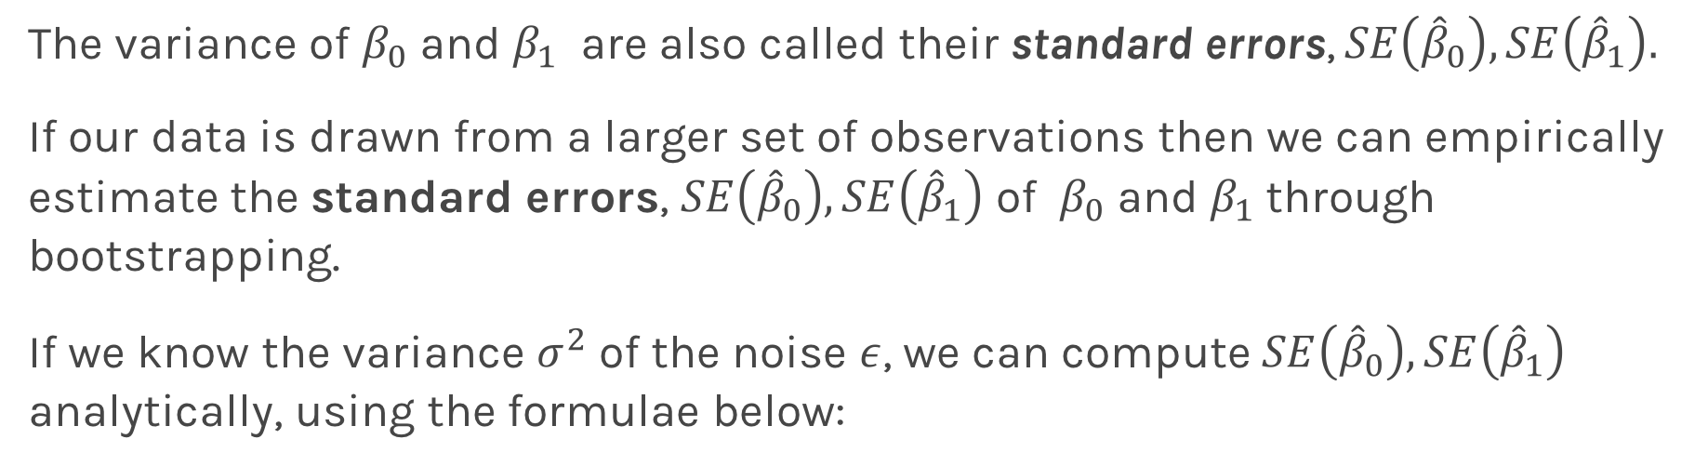
Standard Errors
The variance of $β_{0}$ and $β_{1}$ are also called their standard errors, $SE\left({\hat{β}}_{0}\right),SE\left({\hat{β}}_{1}\right).$
If our data is drawn from a larger set of observations then we can empirically estimate the standard errors, $SE\left({\hat{β}}_{0}\right),SE\left({\hat{β}}_{1}\right)$ of $β_{0}$ and $β_{1}$through bootstrapping.
If we know the variance $σ^{2}$ of the noise $ε$, we can compute $SE\left({\hat{β}}_{0}\right),SE\left({\hat{β}}_{1}\right)$ analytically, using the formulae below:
Notes:
If data set is small this approximation does not work

Slide 60
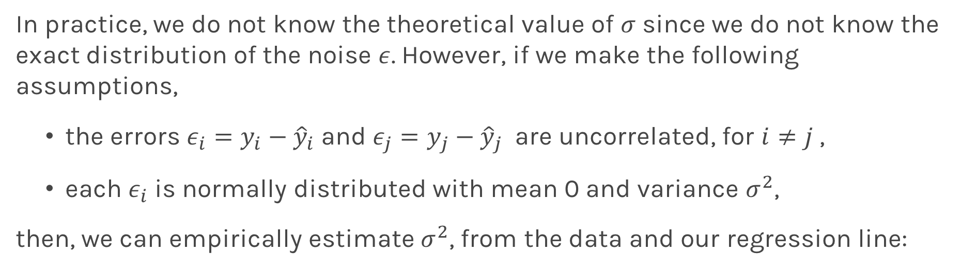
Standard Errors
In practice, we do not know the theoretical value of $σ$ since we do not know the exact distribution of the noise $ε$. However, if we make the following assumptions,
the errors $ε_{i}=y_{i}−{\hat{y}}_{i}$and $ε_{j}=y_{j}−{\hat{y}}_{j}$ are uncorrelated, for $i≠j$ ,
each $ε_{i}$ is normally distributed with mean 0 and variance $σ^{2}$,
then, we can empirically estimate $σ^{2}$, from the data and our regression line:

Slide 61
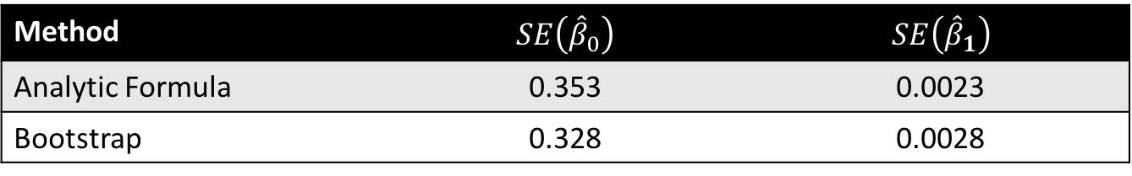
Standard Errors
Exercise: Duplicate the following results for the coefficients for TV advertising.
Method | $$SE\left({\hat{β}}_{0}\right)$$ | $$SE\left({\hat{β}}_{1}\right)$$
Analytic Formula | 0.353 | 0.0023
Bootstrap | 0.328 | 0.0028

Slide 62
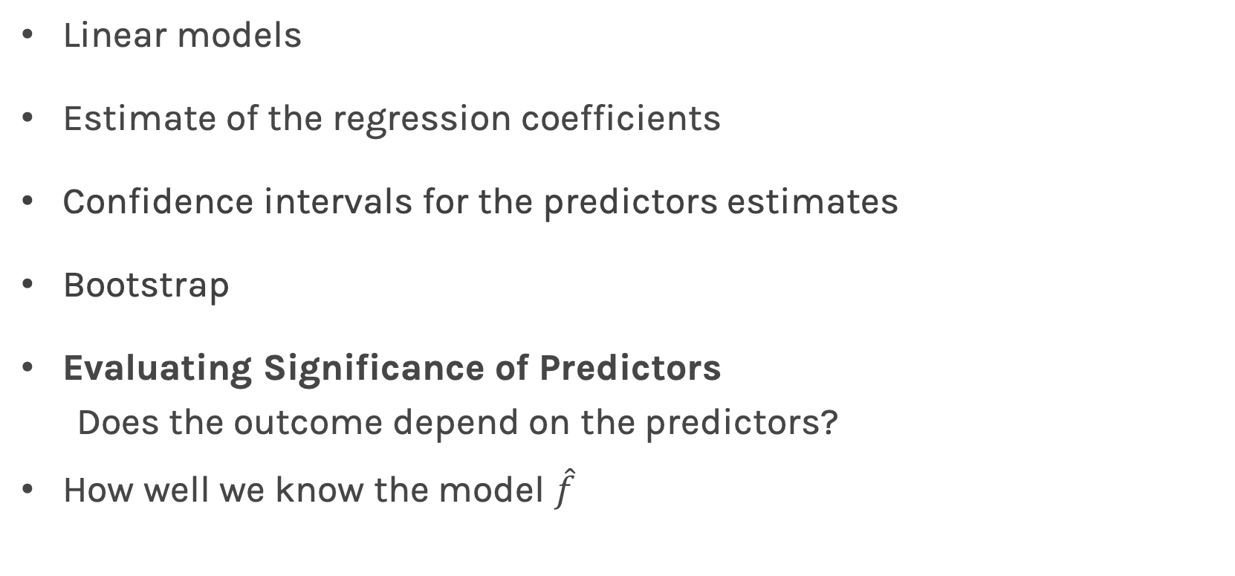
Lecture Outline
Linear models
Estimate of the regression coefficients
Confidence intervals for the predictors estimates
Bootstrap
Evaluating Significance of Predictors
Does the outcome depend on the predictors?
How well we know the model $\hat{f}$

Slide 63
Interpretation of Predictors
Question: What do you think a predictor coefficient means?
$$Y=β_{0}+β_{1}x$$
$$Sales=7.5+0.04 TV$$
What does 7.5 mean and does 0.04 mean?
If we increase the TV by $1000, what would you expect the increase in sales to be? $40!!! Is it worth it?
What if
$$Sales=7.5+1.01 TV$$
Notes:
Axes labels! (DLS)

Slide 64
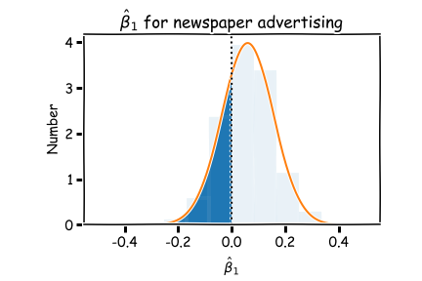


Now we can answer the question, ’how significant are the predictors?’ Here we show the same analysis for all three predictors.
This is called hypothesis testing which we will visit again later in this adventure together.

Slide 65

Importance of predictors
We have discussed finding the importance of predictors, by determining the cumulative distribution from $∞$ to 0.
.

Slide 66


Importance of predictors
This is equivalent in looking the distance of the estimated value of the coefficient in units of SE(${\hat{β}}_{1}$) = $σ_{{\hat{β}}_{1}}$.
.
$$μ_{{\hat{β}}_{1}}−0$$
$$σ_{{\hat{β}}_{1}}$$

Slide 67

Hypothesis Testing
Hypothesis testing is a formal process through which we evaluate the validity of a statistical hypothesis by considering evidence for or against the hypothesis gathered by random sampling of the data.
State the hypotheses, typically a null hypothesis, $H_{0}$ and an alternative hypothesis, $H_{1}$, that is the negation of the former.
Choose a type of analysis, i.e. how to use sample data to evaluate the null hypothesis. Typically this involves choosing a single test statistic.
Sample data and compute the test statistic.
Use the value of the test statistic to either reject or not reject the null hypothesis.

Slide 68

Hypothesis testing
1. State Hypothesis:
Null hypothesis:
$H_{0}$: There is no relation between X and Y
The alternative:
$H_{a}$: There is some relation between X and Y
2: Choose test statistics
To test the null hypothesis, we need to determine whether, our estimate for ${\hat{β}}_{1}$, is sufficiently far from zero that we can be confident that ${\hat{β}}_{1}$ is non-zero. We use the following test statistic:

Slide 69

Hypothesis testing
3. Sample:
Using bootstrap we can estimate ${\hat{β}}_{1}.$
4. Reject or not reject the hypothesis:
If there is really no relationship between X and Y , then we expect that will have a t-distribution with n-2 degrees of freedom.
To compute the probability of observing any value equal to $|t|$ or larger, assuming ${\hat{β}}_{1}=0$ is easy. We call this probability the p-value.
a small p-value indicates that it is unlikely to observe such a substantial association between the predictor and the response due to chance

Slide 70



Hypothesis testing
P-values for all three predictors done independently
Method | $$SE\left({\hat{β}}_{0}\right)$$ | $$SE\left({\hat{β}}_{1}\right)$$
Analytic Formula | 0.353 | 0.0023
Bootstrap | 0.328 | 0.0028
Method | $$SE\left({\hat{β}}_{0}\right)$$ | $$SE\left({\hat{β}}_{1}\right)$$
Analytic Formula | 0.353 | 0.0023
Bootstrap | 0.328 | 0.0028
Method | $$SE\left({\hat{β}}_{0}\right)$$ | $$SE\left({\hat{β}}_{1}\right)$$
Analytic Formula | 0.353 | 0.0023
Bootstrap | 0.328 | 0.0028

Slide 71

Lecture Outline
Linear models
Estimate of the regression coefficients
Confidence intervals for the predictors estimates
Bootstrap
Evaluating Significance of Predictors
Does the outcome depend on the predictors?
How well we know the model $\hat{f}$

Slide 72

How well do we know $\hat{f}$?
Our confidence in $f$ is directly connected with the confidence in $β$s. So for each $β$ we can make a prediction.

Slide 73

How well do we know $\hat{f}$?
Here we show two difference set of predictions given the fitted coefficients for a given subsample

Slide 74

How well do we know $\hat{f}$?
There is one such regression line for every imaginable sub-sample.

Slide 75


How well do we know $\hat{f}$?
Below we show all regression lines for a thousand of such sub-samples.
For a given $x$, we examine the distribution of $\hat{y}$, and determine the mean and standard deviation.

Slide 76

How well do we know $\hat{f}$?
For every $x$, we calculate the mean of the predictions, $\hat{y}$ (shown with dotted line) and the 95% CI of those predictions (shaded area).

Slide 77
What’s next?
So far we have examined only one predictor at the time. Next lecture we will see how to use multiple predictors together and evaluate the significance of each predictor when cofounding effects are present.

